Slide 1
B4M36SAN
2. lab

Slide 2
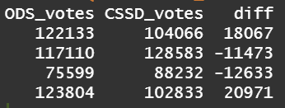
Previously

Slide 3
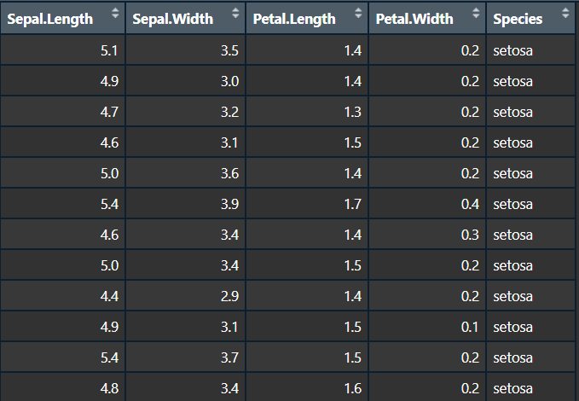
This week
Visualization basics
Statistics basics
Explore penguins dataset
chinstrap_penguin.jpg (1482×2000) (burrard-lucas.com)

Slide 4
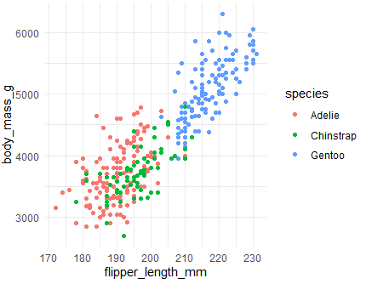
Task – try scatter plots
Replicate following graphs. How each penguin species look like according to them?

Slide 5
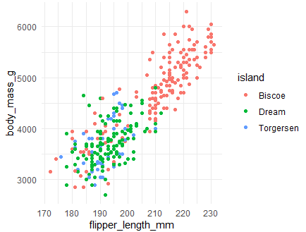
Task – explore more palletes
https://www.r-graph-gallery.com/38-rcolorbrewers-palettes

Slide 6
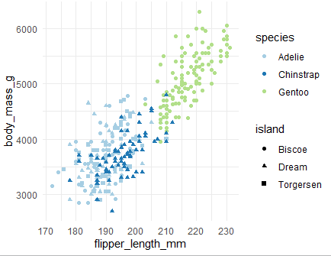
Merging two plots

Slide 7
More vizualization
The R Graph Gallery – Help and inspiration for R charts (r-graph-gallery.com)
Boxplots
Histograms
Dognut charts
Heatmaps
Time series
More in future labs

Slide 8
Statistical part
statistical
https://i.ytimg.com/vi/jSaMm1lK_j8/maxresdefault.jpg

Slide 9
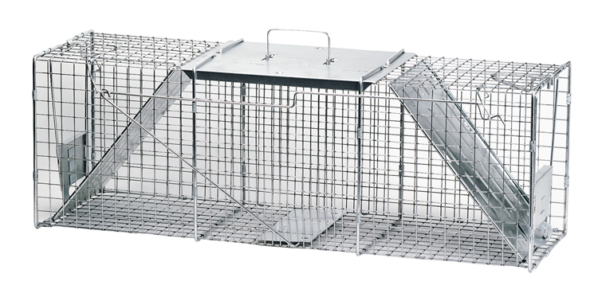
Hypothesis testing - intuition
xlLive2.jpg (750×368) (biconet.com)

Slide 10
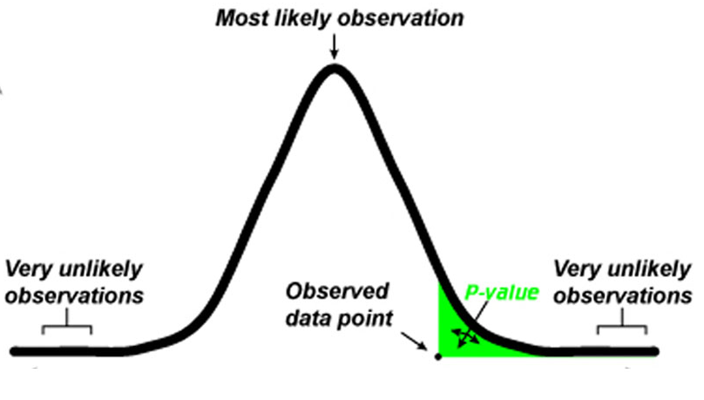
Statistical part – hypothesis testing
The bird is a penguin –> let it go
H₀: Null hypothesis (Hypothesis we assume is true)
H_{A}: Alternative hypothesis
If the observation is too unlikely under H₀, we say we
“reject the null hypothesis in favor of the alternative hypothesis”
What is likely/unlikely?
p-value
probability of the observation (or more extreme one) under H₀
α-level (significance level)
Intuitively threshold for p-value
It’s up to us!
Point unlikely when p < α
The bird we just caught is NOT a penguin -> notify
How likely/unlikely is that a penguin would have such a weight?
http://med.stanford.edu/content/dam/sm-news/images/2016/03/p-value-index.jpg

Slide 11
Voluntary task
State the null hypothesis and the alternative hypothesis.
How would proceed to reject/not reject the null hypothesis (no need for calculations).
Bartender with the following beers is unfair
490ml, 452ml, 466ml, 492ml, 460ml, 523ml, 488ml, 492ml, 480ml
Older people (60+) vote more for ANO, than younger people
Upload as .txt .doc .pdf on BRUTE

Slide 12
Summary
How to create basic plots with ggplot
What aes()does
Understand the role of standard deviation (variance) in normal distribution
What terms like p-value, alpha level, null hypothesis mean
Not covered
Z-score
Type I and type II errors in hypothesis testing
Types of t-test (one-sample, two-sample, paired)

