Slide 1
Advanced clustering
B4M36SAN

Slide 2
Outline
Review of baseline methods
K-means, Hierarchical clustering, DBSCAN
Spectral clustering
Principles and intuition, Showcase
DIY implementation
K-means on steroids
Relation to LDA and PCA
Ensemble clustering
For the mother-cluster!
kmeans
kmeans
kmeans
kmeans
kmeans
kmeans

Slide 3
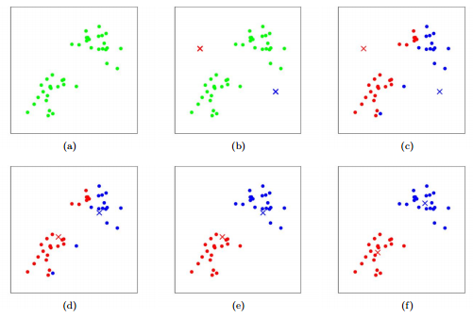
K-means
Advantages:
Fast, easy, simple
Susceptible to:
Cluster shapes and densities
Initialization
Outliers
- Predefined number of clusters*
Notes:
How k-means work? Can you walk me through these images? I’ll give you a few moments…(solution)...Any disadvantages (globular, outlier)
Now how hierarchical clustering works (use the image)?

Slide 4
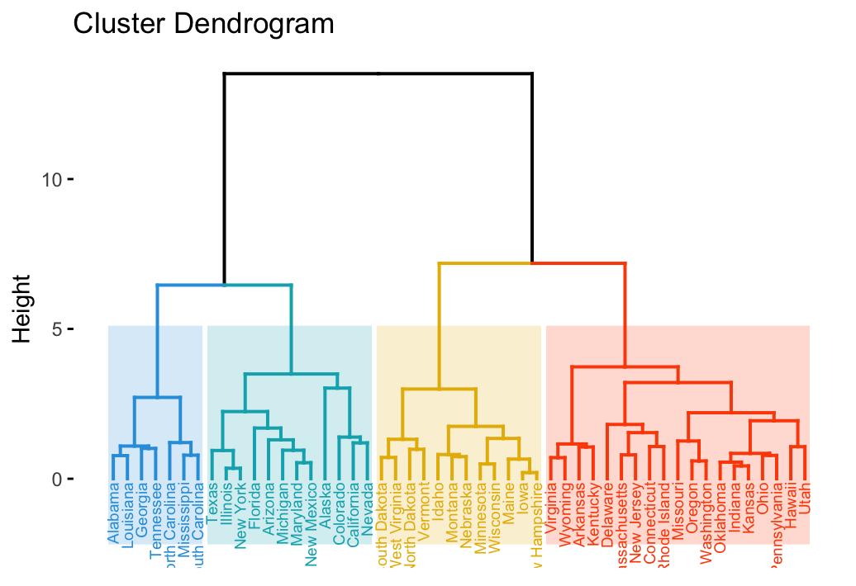
Hierarchical clustering
Advantages:
More informative hierarchical structure
Can vary number of clusters without re-computation
Susceptible to:
Noise (single link)
Outliers (complete link)
Non-spherical clusters (average link)

Slide 5
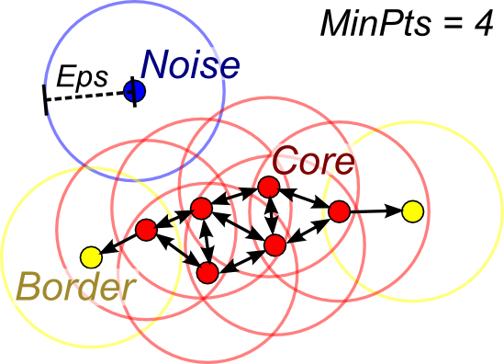
DBSCAN
Advantages:
Cluster shapes are not an issue
Robust towards outliers/noise
Susceptible to:
Cluster densities
Parametrization (eps, MinPts)

Slide 6
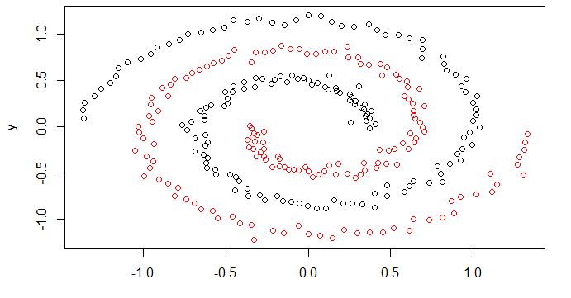
Datasets
2 spirals dataset
Jain dataset
Experiment yourself

Slide 7
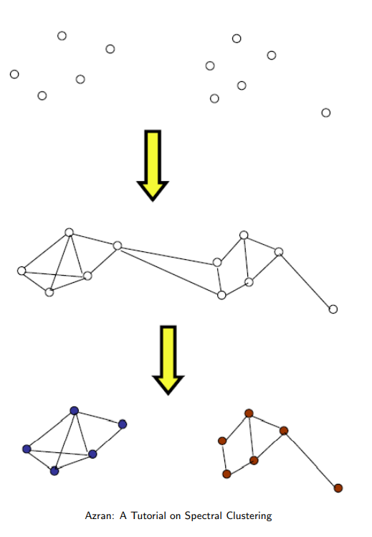
Spectral clustering
Turns data into a graph
Finds a min-cut of the graph
The partition forms the clusters
Simple idea, not so simple steps

Slide 8
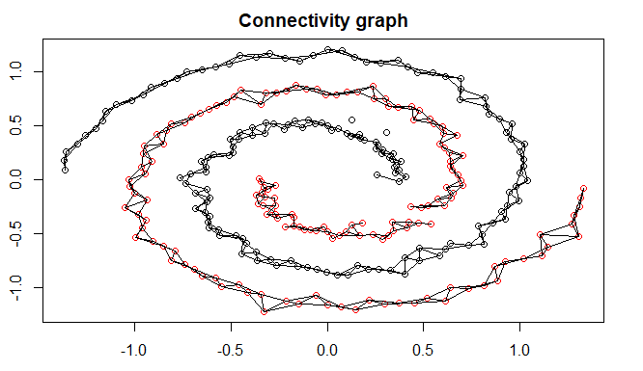
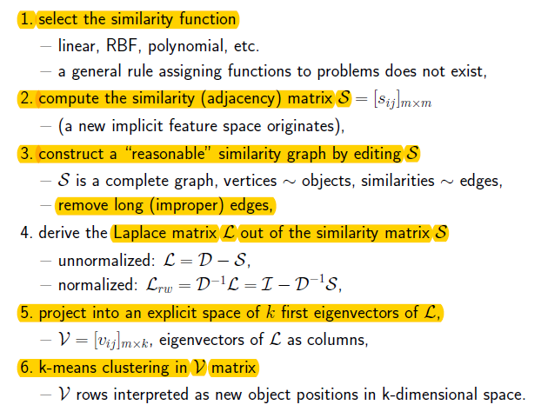
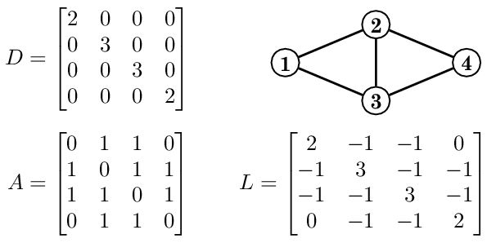
Spectral clustering

Slide 9
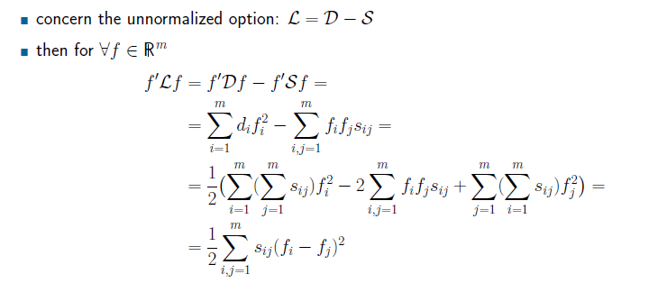
Why 2nd eigenvector?
2nd eigenvector is f, that minimizes this function
(without proof)
But what is this function telling?
It’s a cost function!
If two points are connected i.e s_{ij}=1,
it penalizes the difference in their labels

Slide 10
K-means relation to PCA and LDA
Initialization issues
Repeated starts
PCA-Part
A divisive hierarchical approach based on PCA.
Starting from an initial cluster that contains the entire data set, the iteratively select the cluster with the greatest SSE and divide it into two subclusters using a hyperplane that passes through the cluster centroid and is orthogonal to the principal eigenvector of the cluster covariance matrix. This procedure is repeated until K clusters are found Celebi, M.E., Kingravi, H.A. and Vela, P.A., 2013. A comparative study of efficient initialization methods for the k-means clustering algorithm.

Slide 11
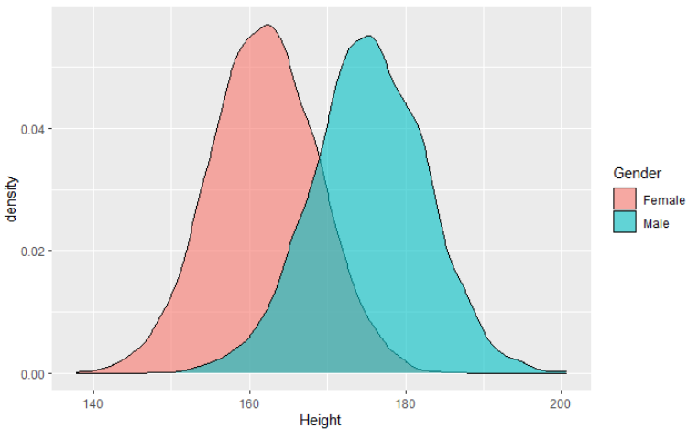
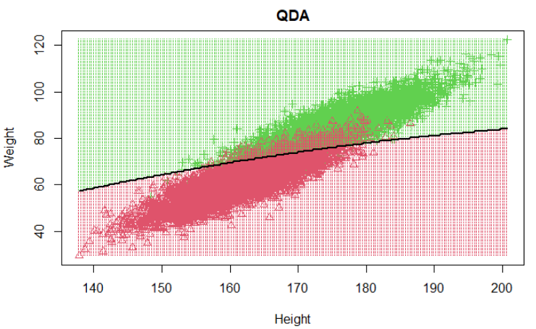
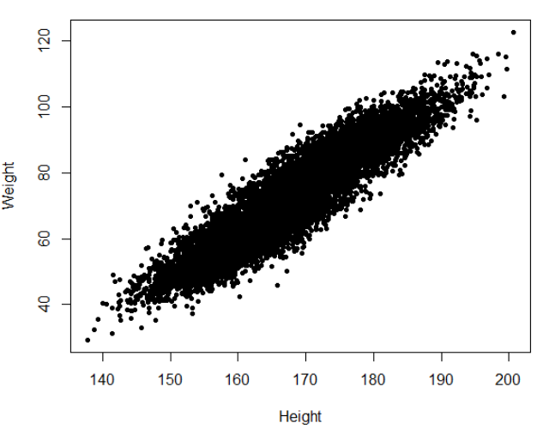
K-means relation to PCA and LDA
LDA
Assumes data for each class come from (mulitvar.) normal distributions
Uses Bayes theorem to decide which class a sample belongs to
EM-GMM clustering
Soft version of K-means
Also assumes data for each cluster come from (mulitvar.) normal distributions
The parameters estimated are μ_{c},σ_{c} and p_{c} of the clusters

Slide 12
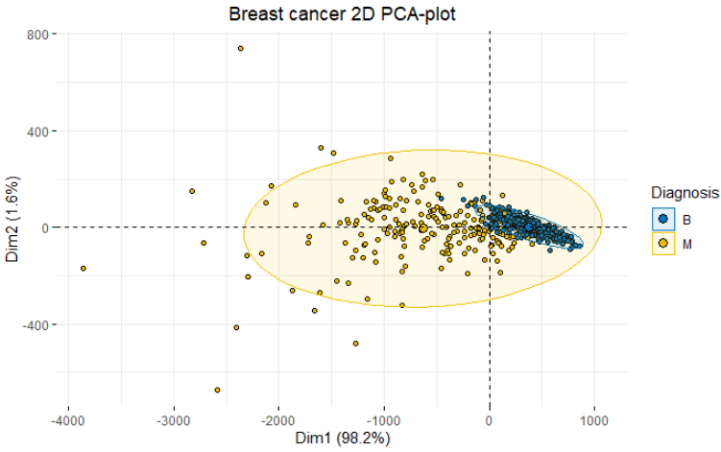
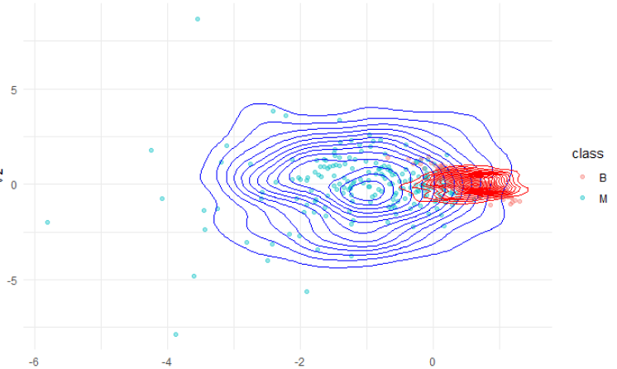
EM clustering on Breast cancer dataset
Demo in the ./extra folder of the course materials

Slide 13
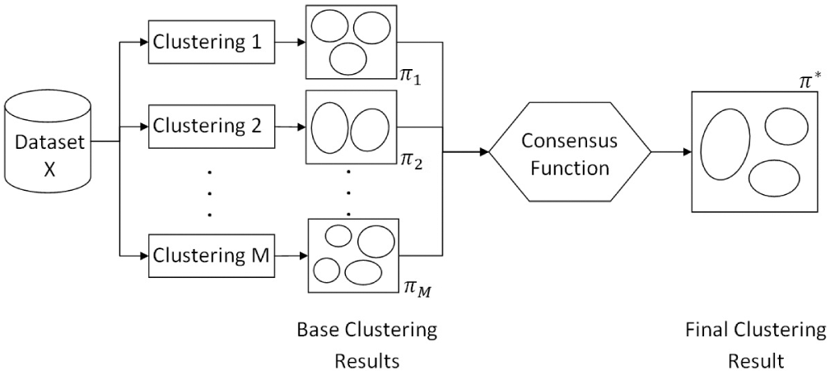
Ensemble clustering

Slide 14
How to generate clusters?
Using different clustering algorithms e.g. K-means, hierarchical clustering, spectral clustering, …
Running the same algorithm with different parameters or initializations, e.g.,
use different dissimilarity measures
use different number of clusters
Using different samples of the data

Slide 15
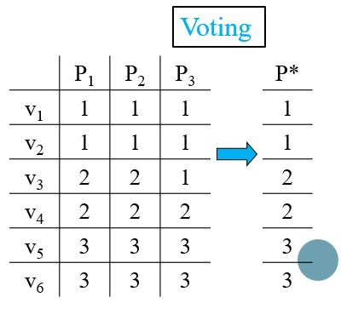
How to combine the partitions?
Median partition based approaches
“Averaging” all ensemble partitions
Co-occurrence based approaches
Relabeling/voting based methods
Co-association matrix based methods
Graph based methods

Slide 16
Resources
http://www.cse.msu.edu/~cse802/EnsembleClustering_Jinfeng_jain.pptx
https://stanford.edu/~cpiech/cs221/handouts/kmeans.html
https://csdl-images.computer.org/trans/tk/2012/03/figures/ttk20120304131.gif
https://www.researchgate.net/figure/An-example-of-the-Laplacian-matrix-of-a-simple-network-n-4_fig1_305653264
https://images.amcnetworks.com/ifc.com/wp-content/uploads/2015/03/EnemyAtTheGates_MF.jpg
https://gfycat.com/somelonelycaterpillar
Luxburg07_tutorial_spectral_clustering.pdf (mit.edu)
[1209.1960] A Comparative Study of Efficient Initialization Methods for the K-Means Clustering Algorithm (arxiv.org)
Rajaraman, Anand, and Jeffrey David Ullman. Mining of massive datasets. Cambridge University Press, 2011.

