Slide 1
Advanced algorithms binary heap, d-ary heap, binomial heap, amortized analysis, Fibonacci heap
Jiří Vyskočil, Radek Mařík
2013

Slide 2
Heaps [haldy]
heap
a heap is a specialized data structure (usually tree-based) that satisfies the heap property:
If B is a child node of A, then key(B) ≥ key(A).
The heap is one the most efficient implementation of an abstract data type called a priority queue.
The operations commonly performed with a heap are:
Insert (x)
adds a new key x to the heap.
AccessMin
finds and returns the minimum item of the heap.
DeleteMin
removes the minimum node of the heap (usually, the minimum node is the root of a heap).
DecreaseKey (x,d)
decreases x key within the heap by d.
Merge (H₁, H₂)
joins two heaps H₁ and H₂ to form a valid new heap containing all the elements of both.
Delete (x)
removes a key x of a heap.

Slide 3
Binary Heap [binární halda]
binary heap
A binary heap is a binary tree with two additional constraints:
It is a complete binary tree except the last level; that is, all levels of the tree, except possibly the last one (deepest) are fully filled. If the last level of the tree is not complete, the nodes of that level are filled from left to right.
Each node is less than or equal to each of its children according to a comparison predicate ≤ over keys.

Slide 4
Binary Heap - Insert
Insert (x)
Add a node x at the end of the heap;
while ( key(parent(x)†) > key(x) ) {
Swap a location of the node x with the node parent(x);
}
†parent(x) returns the parent of a node x. It returns x in the case where x has no parent.
3
3
3

Slide 5
Binary Heap
AccessMin
Returns the root of the heap’s binary tree.
DeleteMin
&x = a location of the root of the heap;
key(x) = +∞;
&y = a location of the last node of the heap;
do {
Swap a location of the node x with a location of the node y;
&x = &y;
for each z ∈ descendants(x) do
if ( key(y) > key(z) ) then &y = &z;
} while ( &x ≠ &y );
Remove the last node of the heap.
DecreaseKey (x , d )
First, decrease the key of x by d and then apply the similar algorithm as in Insert case.

Slide 6
Binary Heap - Delete
Delete (&x)
key(x) = +∞; &y = a location of the last node of the heap;
do {
Swap a location of the node x with a location of the node y;
&x = &y;
for each z ∈ descendants(x) do
if ( key(y) > key(z) ) then &y = &z;
} while (&x ≠ &y );
while ( key(parent(x)) > key(x) ) {
Swap a location of the node x with the node parent(x);
}
Remove the last node of the heap.
+∞

Slide 7
Binary Heap - Representation
data representation
bidirectional tree structure (using pointers)
array (the root is placed at index 1)
2nd child
(2*n)+1
or equivalently (n << 1) + 1
…
parent
n div 2
or equivalently n >> 1
node
n
1st child
2*n
or equivalently n << 1

Slide 8
Binary Heap - BuildHeap
BuildHeap ( array A )
for i = $\left\lfloor \frac{length(A)}{2}\right\rfloor$ downto 1 do {
Heapify(A,i);
}
Heapify ( array A, index i )
min = i;
do {
left = 2∙i;
right = 2∙i + 1;
if (left ≤ length(A)) and (A[left] < A[min]) then min = left;
if (right ≤ length(A)) and (A[right] < A[min]) then min = right;
if min = i then break;
swap A[i] ↔ A[min];
i = min;
} while true;

Slide 9
Binary Heap – Time Complexity
Insert
O(log(n))
Delete
O(log(n))
AccessMin
O(1)
DeleteMin
O(log(n))
DecreaseKey
O(log(n))
BuildHeap
$\sum_{h=0}^{\left\lceil \log\left(n\right)\right\rceil }{\left(\text{number} \text{of} \text{nodes} \text{at} \text{heigh} h\right)∙Ο(h)≤\sum_{h=0}^{\left\lceil \log\left(n\right)\right\rceil }{\left\lceil \frac{n}{2^{h+1}}\right\rceil ∙Ο(h)≤}Ο(n∙\sum_{h=0}^{∞}{\frac{h}{2^{h}})=}}$ O(n)
Merge
O(n) by building a new heap.

Slide 10
d-ary heap [d-regulární halda]
A d-ary heap is a generalization of the binary heap in which the nodes have d children instead of 2.
Operations for d-ary heap are analogical to the operations for binary heap.
Asymptotic time complexity of d-ary heap operations is the same as binary heap operations.
Exact complexity differs because of a different logarithm base (the base is d). For Delete operation it is needed to check d instead of 2 descendants in every loop.
For an efficient implementation it is convenient to choose d as powers of 2. In this case, bit shifts can be used for traversing the array representation.
A d-ary heap typically runs much faster than a binary heap for heap sizes that exceed the size of the computer's cache memory.

Slide 11
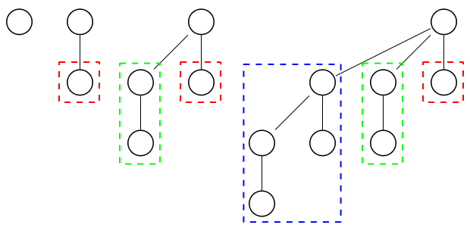
Binomial Heap [binomiální halda]
binomial heap
A binomial heap is a collection of binomial trees of degrees: i=0,…,⌊log(n)⌋. There can only be either one or zero binomial trees for each degree, including zero degree. Each binomial tree in a heap obeys the heap property: the key of a node is less than or equal to the key of its child.
A binomial tree is defined recursively:
A binomial tree of order 0 is a single node
A binomial tree of degree k has a root node whose children are roots of binomial trees of degrees k−1, k−2, ..., 2, 1, 0 (in this order).
degree: 0 1 2 3

Slide 12
Binomial Heap – Binomial Tree
for a binomial tree B_{k} (of degree k) it holds:
It satisfies the heap property,
the height of the tree is k,
its root has k children,
there are 2^{k} nodes,
there are exactly $\left({k \atop i}\right)$ nodes at depth i for i = 0, 1, ..., k.
an alternative definition of a binomial tree:
A binomial tree B_{k} (of degree k) consists of two binomial trees B_{k-1} (of degree k-1) that are linked together: the root of one, which is greater than the other, is the leftmost child of the root of the other.

Slide 13
Binomial Heap – representation
Because no operation requires random access to the root nodes of the binomial trees, the roots of the binomial trees can be stored in a linked list, ordered by increasing degree of the tree. But of course, binomial trees can be stored in array as well.
The whole binomial heap is formed by binomial trees and an additional pointer to a binomial tree with a the minimum node of the whole heap (MIN pointer ). MIN is always root by the heap property. MIN must be updated when performing any operation other than AccessMin. This can be done in O(log n) without raising the running time of any operation.

Slide 14
Binomial Heap – Insert, AccessMin, Merge
Insert (x)
Create a new heap containing only this element (there is only one tree of degree 0).
Merge it with the original heap.
AccessMin
It returns the root of a binomial tree from MIN pointer.
Merge (H₁, H₂)
Because each binomial tree in a binomial heap corresponds to a bit in the binary representation of its size, there is an analogy between the merging of two heaps and the binary addition of the sizes of the two heaps, from right-to-left. Whenever a carry occurs during addition, this corresponds to a merging of two binomial trees during the merge. Due to the structure of binomial trees, they can be merged trivially. As their root node is the smallest element within the tree, by comparing the two keys, the smaller of them is the minimum key, and becomes the new root node. Then the other tree becomes a subtree of the combined tree. In the end, we update MIN pointer.

Slide 15
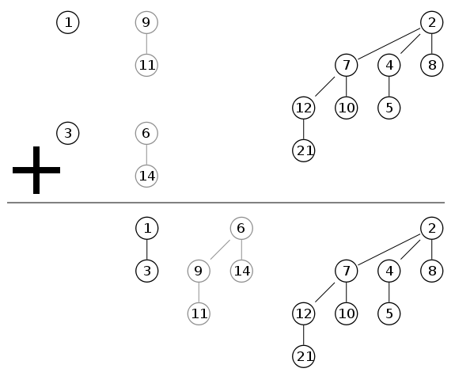
Binomial Heap - Merge
MIN
MIN
MIN

Slide 16
Binomial Heap - DeleteMin
procedure DeleteMin(binomial_heap H)
tree_with_minimum = H.MIN;
for each tree ∈ tree_with_minimum.subTrees do {
tmp.addTree(tree);
}
H.removeTree(tree_with_minimum )†;
H = Merge(H, tmp);
† Technically, this operation removes only the root of tree_with_minimum. All children subtrees of the root are used in tmp heap which is merged at line 7.

Slide 17
Binomial Heap – DecreaseKey, Delete
DecreaseKey
It is analogical to binary heap DecreaseKey.
After decreasing the key of an element, it may become smaller than the key of its parent, violating the heap property. If this is the case, exchange the element with its parent, and possibly also with its grandparent, and so on, until the heap property is no longer violated. Each binomial tree has height at most log n, so this takes O(log n) time.
Delete (x)
decrease x key to -∞ (that is, some value lower than any element in the heap) by DecreaseKey.
delete the minimum in the heap by DeleteMin.

Slide 18
Binomial Heap – Time Complexity
Merge
O(log(n))
Insert
O(log(n))
The amortized complexity is O(1). It is analogical to a binary counter increment.
AccessMin
O(1)
DeleteMin
O(log(n))
DecreaseKey
O(log(n))
Delete
O(log(n))

Slide 19
Amortized Complexity [amortizovaná složitost]
In an amortized analysis, the time required to perform a sequence of data-structure operations is averaged over all the operations performed.
Amortized analysis can be used to show that the average cost of an operation is small, if one averages over a sequence of operations, even though a single operation within the sequence might be expensive.
Amortized analysis differs from average-case analysis in that probability is not involved; an amortized analysis guarantees the average performance of each operation in the worst case.

Slide 20
Amortized Complexity
Example: A Complexity of INSERT in a dynamic array
A dynamic array is an array which resizes by a doubling in size in the case that it is full, and uses the reserved space for future expansions.
INSERT without resize requires O(1), for N elements without resize O(N).
If the array is full then the reallocation (resizing) is needed. In the worst case, this operation takes O(N).
For insertion of N elements including reallocation we need in the worst case O(N/2) + O(N/4) +...+ O(N/2 ^{⎣log N⎦}) + O(N) = O(N) + O(N) = O(N).
$$\sum_{i=0}^{\left\lfloor \log{N}\right\rfloor }{\left\lfloor \frac{N}{2^{i}}\right\rfloor } < N∙\sum_{i=0}^{∞}{\frac{1}{2^{i}} = 2N}$$
Then the amortized time complexity for one INSERT operation is O(N)/N = O(1).

Slide 21
Fibonacci Heap [Fibonacciho halda]
A Fibonacci heap, in fact, is loosely based on binomial heap.
Fibonacci heaps have a more relaxed structure than binomial heaps, however, allowing for improved asymptotic time bounds.
Fibonacci heaps support the same operations but have the advantage that operations that do not involve deleting an element (AccessMin, Merge, and DecreaseKey) run in O(1) amortized time.
Operations Delete and DeleteMin have O(log(n)) amortized time complexity.
The usage of Fibonacci heaps is not suitable for real-time systems, because some operations can have a linear time complexity in the worst case.
From a practical point of view, however, the constant factors and programming complexity of Fibonacci heaps make them less desirable than ordinary binary (or d-ary) heaps for most applications.

Slide 22
Fibonacci Heap
Like a binomial heap, a Fibonacci heap is a collection of trees that satisfy the heap property.
Unlike trees within binomial heaps, which are ordered, trees within Fibonacci heaps are rooted but unordered.
An unordered binomial tree is like a binomial tree, and it is also defined recursively. The unordered binomial tree U₀ consists of a single node, and an unordered binomial tree U_{k} consists of two unordered binomial trees U_{k-1} so that the root of one is made into any child of the root of the other.
Compared with binomial heaps, the structure of a Fibonacci heap is more flexible. The trees do not have a prescribed shape and in the extreme case the heap can have every element in a separate tree.
This flexibility allows some operations to be executed in a "lazy" manner, postponing the work for later operations. For example merging heaps is done simply by concatenating the two lists of trees, and sometimes operation decrease key cuts a node from its parent and forms a new tree.

Slide 23
Fibonacci Heap – Fibonacci Trees
Every node has degree (= the number of children) at most O(log n) and the size of a subtree rooted in a node of degree k is at least F _{k +2}, where F _{k} is the k-th Fibonacci number. $\begin{matrix}{\text{F}}_{n}=\left\{\begin{matrix}0, \text{for} n=0; \\ 1, \text{for} n=1; \\ {\text{F}}_{n−2}+{\text{F}}_{n−1} \text{otherwise}\text{.}\end{matrix}\right. & ⇔ & {\text{F}}_{n}=\frac{φ^{n}−{(−φ)}^{−n}}{\sqrt{5}}\end{matrix} \text{where} φ=\frac{1+\sqrt{5}}{2}≈1.618$;
This is achieved by the following two Fibonacci tree rules:
We can cut at most one child of each non-root node.
When a second child is cut, the node itself needs to be cut from its parent and becomes the root of a new tree.
The number of trees is decreased in the operation DeleteMin, where trees are consolidated together.

Slide 24
Fibonacci Heap – Representation
MIN
Unlike trees within binomial heaps, which are ordered, trees within Fibonacci heaps are rooted but unordered. Each node x contains a pointer to its parent and a pointer to any one of its children. The children of x are linked together in a circular, doubly linked list.
The roots of all the trees in a Fibonacci heap are linked together into a circular, doubly linked list called the root list of the Fibonacci heap.
MIN

Slide 25
Fibonacci Heap – Representation
N is the actual number of elements in the heap.
MIN is a pointer to the minimum element in the heap. It must be always a root from the root list of the heap.
key(x) is a value of the key of the element x.
mark(x) is a Boolean value which indicates whether node x has lost a child since the last time x was made the child of another node. Newly created nodes are unmarked, and a node x becomes unmarked whenever it is made the child of another node.
descendants(x) returns all children of x.
parent(x) returns parent of a node x. It returns x in case where x has no parent.

Slide 26
Fibonacci Heap – Merge, Insert
Merge (H₁, H₂)
Connect both doubly cyclic linked lists to one and then update pointer to MIN.
O(1)
AccessMin
It returns the root of the Fibonacci tree from MIN pointer.
O(1)
Insert (x)
Create a new heap containing only x element (there is only one tree of degree 0).
mark(x) = false;
Merge it with the original heap.
O(1)

Slide 27
Fibonacci Heap – DeleteMin
DeleteMin
z = MIN;
if z ≠ null then {
for each x ∈ descendants(z) do
add x to the root list of the heap;
remove z from the root list of the heap;
if N = 1 then
MIN = null
else {
MIN = any pointer to a root from the root list of the heap;
Consolidate;
}
N--;
}
time complexity: O(N)
amortized: O(log(N))

Slide 28
Fibonacci Heap – Consolidate
Consolidate
for i = 0 to max. possible degree of a tree in Fibonacci heap of size N do A[i] = null;
for each w ∈ all trees in the root list of the heap do {
x = w; d = a degree of the tree w;
while A[d] ≠ null do {
y = A[d];
if key(x) > key(y) then swap x and y;
remove y from the root list of the Heap;
make y a child of x, incrementing the degree of x;
mark(y) = false; A[d] = null; d++;
}
A[d] = x;
}
MIN = null;
for i = 0 to max. degree of a tree in the array A do
if A[i] ≠ null then {
add A[i] to the root list of the heap;
If (MIN = null) or (key(A[i]) < key(MIN)) then MIN = A[i];
}
time complexity: O(N)
amortized: O(log N)

Slide 29
Fibonacci Heap – DeleteMin Example
Consider the following Fibonacci heap.
The situation after the minimum node z is removed from the root list and its children are added to the root list.
MIN
MIN

Slide 30
Fibonacci Heap – DeleteMin Example
The array A and the trees after each of the first three iterations of the for each loop of lines 2-12 of the procedure Consolidate. The root list is processed by starting at the node pointed to by MIN and following right pointers. Each part shows the values of w and x at the end of an iteration.

Slide 31
Fibonacci Heap – DeleteMin Example
The Figure shows the situation after the first time through the while loop. The node with key 23 has been linked to the node with key 7, which is now pointed to by x.

Slide 32
Fibonacci Heap – DeleteMin Example
The node with key 17 has been linked to the node with key 7, which is still pointed to by x.
The node with key 24 has been linked to the node with key 7. Since no node was previously pointed to by A[3], at the end of the for each loop iteration, A[3] is set to point to the root of the resulting tree.

Slide 33
Fibonacci Heap – DeleteMin Example
The situations after each of the next four iterations of the for each loop.

Slide 34
Fibonacci Heap – DeleteMin Example

Slide 35
Fibonacci Heap – DeleteMin Example
The Fibonacci heap after reconstruction of the root list from the array A and determination of the new MIN pointer.
MIN

Slide 36
Fibonacci Heap – DecreaseKey, Delete
DecreaseKey (x,d)
key(x) = key(x) – d;
y = parent(x);
if (x ≠ y) and (key(x) < key(y)) then {
Cut(x,y);
Cascading-Cut(y);
}
If key(x) < key(MIN) then MIN = x;
time complexity: O(log N)
amortized: O(1)
Delete(x)
DecreaseKey(x,∞)
DeleteMin;
time complexity: O(N)
amortized: O(log N)
Cascading-Cut (y)
z = parent(y);
if (y ≠ z) then
if mark(y) = false then mark(y) = true
else {
Cut(y,z);
Cascading-Cut(z);
}
time complexity: O(log N)
amortized: O(1)
Cut(x,y)
remove x from the child list of y, decrementing the degree of y;
add x to the root list of the heap;
mark(x) = false;
time complexity: O(1)

Slide 37
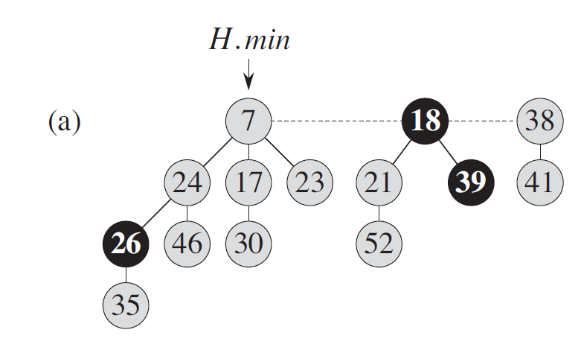
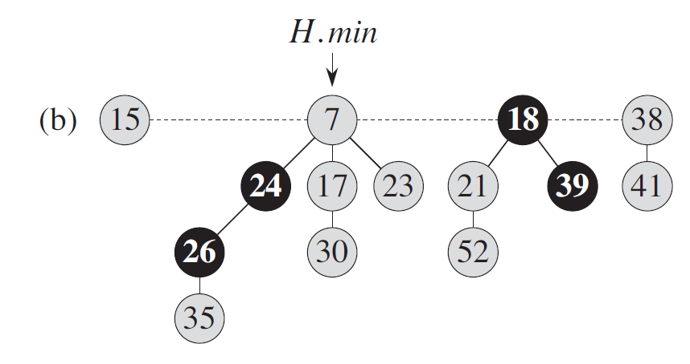
Fibonacci Heap – DecreaseKey Example
(a) The initial Fibonacci heap.
(b) The node with key 46 has its key decreased to 15. The node becomes a root and its parent (key 46, previously unmarked) becomes marked.

Slide 38
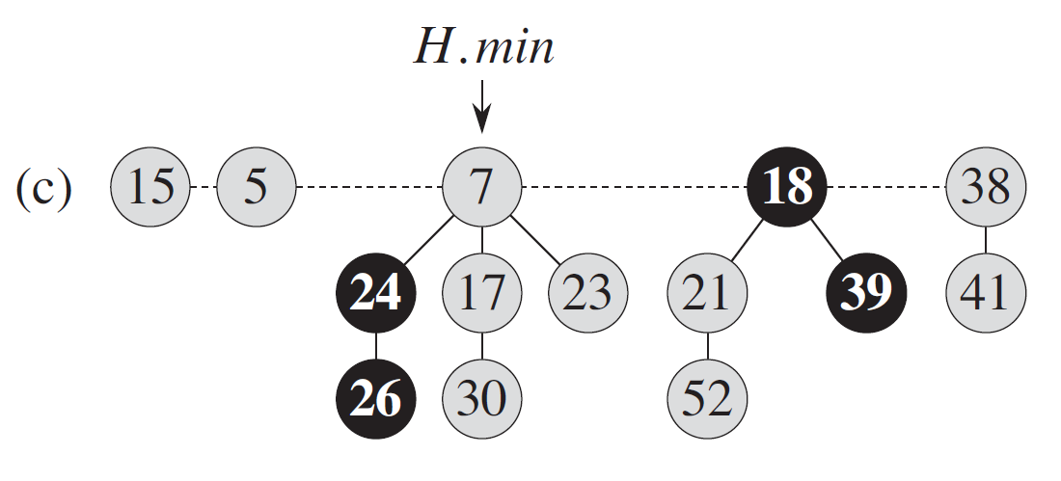
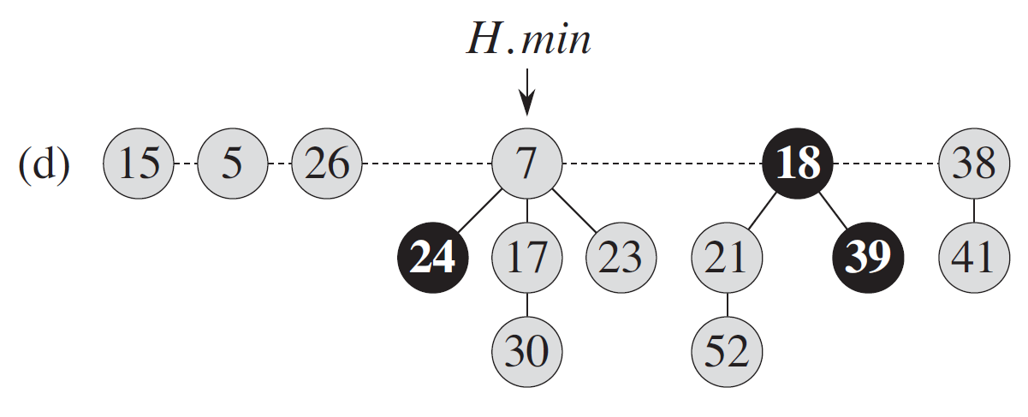
Fibonacci Heap – DecreaseKey Example
(c) The node with key 35 has its key decreased to 5. It now becomes a root. Its parent, with key 26, is marked, so a cascading cut occurs.
(d) The node with key 26 is cut from its parent and made an unmarked root. Another cascading cut occurs, since the node with key 24 is marked as well.

Slide 39
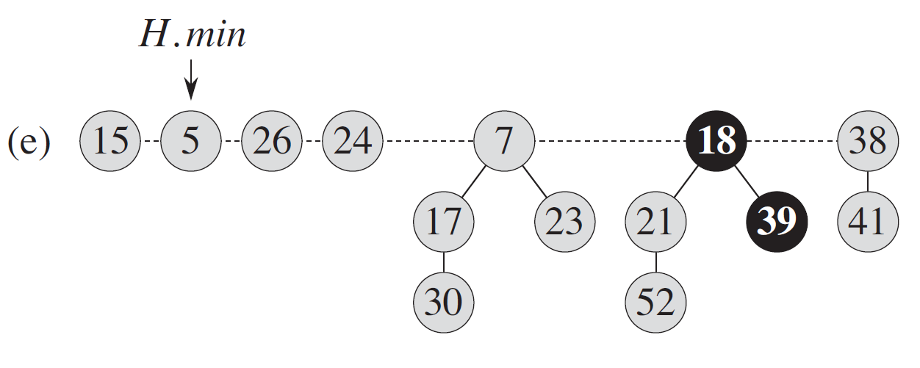
Fibonacci Heap – DecreaseKey Example
(e) The node with key 24 is also cut form its parent and made an unmarked root. The cascading-cut stops at this point since the node with key 7 is a root. The H.min pointer is updated.

Slide 40
Heaps – Comparison of Time Complexity
 | binary heap | d -ary heap | binomial heap | Fibonacci heap
AccessMin | Θ(1) | Θ(1) | Θ(1) | Θ(1)
DeleteMin | Θ(log(n)) | Θ(log(n)) | Θ(log(n)) | O(n) amortized: O(log(n))
Insert | Θ(log(n)) | Θ(log(n)) | O(log(n)) amortized: O(1) | Θ(1)
Delete | Θ(log(n)) | Θ(log(n)) | O(log(n)) | O(n) amortized: O(log(n))
Merge | Θ(n) | Θ(n) | O(log(n)) | Θ(1)
DecreaseKey | Θ(log(n)) | Θ(log(n)) | Θ(log(n)) | O(log(n)) amortized: O(1)

Slide 41
References
Cormen, Thomas H.; Leiserson, Charles E.; Rivest, Ronald L.; Stein, Clifford (2001). Introduction to Algorithms (2nd ed.). MIT Press and McGraw-Hill. ISBN 0-262-53196-8.
Fredman, M. L. ; Tarjan, R. E. Fibonacci heaps and their uses in improved network optimization algorithms. J. ACM 34(1987), 596-615.

