Slide 1
Kognitivní
architektury
Michal Vavrečka
Incognite, CIIRC, CTU Prague
Notes:
1

Slide 2
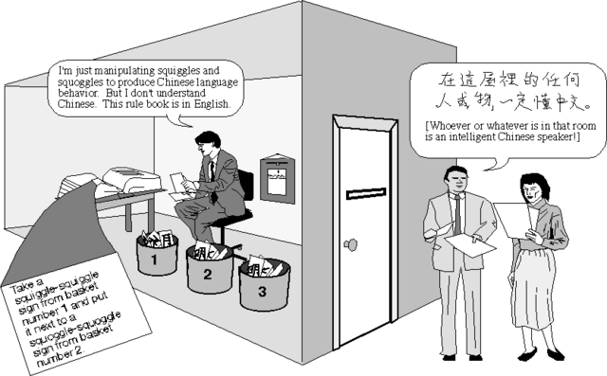
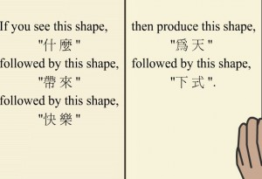
Chinese room experiment
The Chinese Room argument, devised by John Searle (1980), is an argument against the possibility of true artificial intelligence. Searle argues that computers merely use syntactic rules to manipulate symbol strings, but have no understanding of meaning or semantics.
Notes:
2

Slide 3
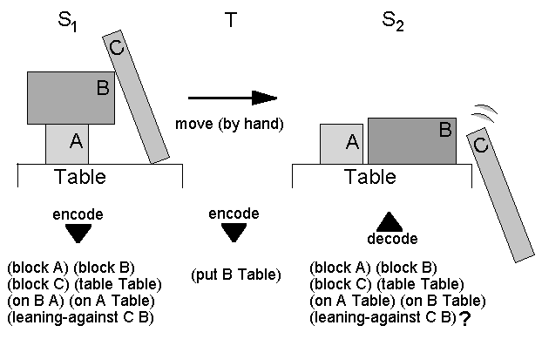
Physical symbolic system

Slide 4
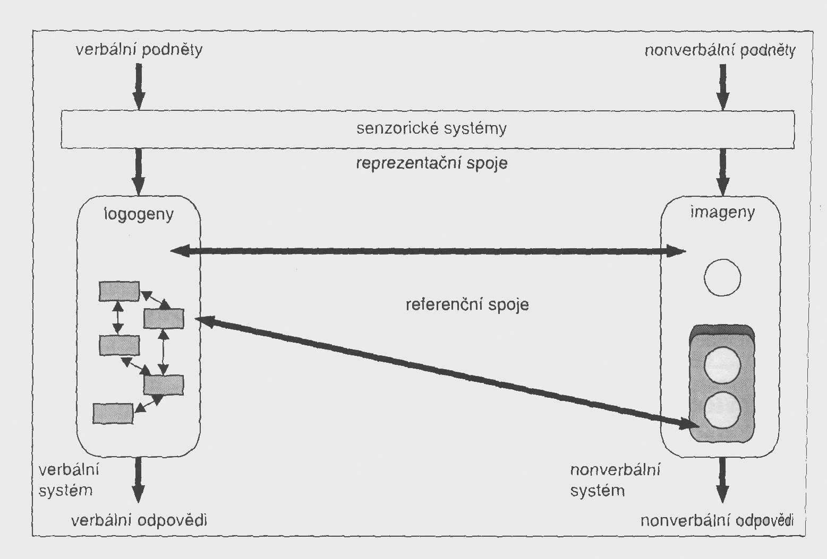
Dual coding theory

Slide 5
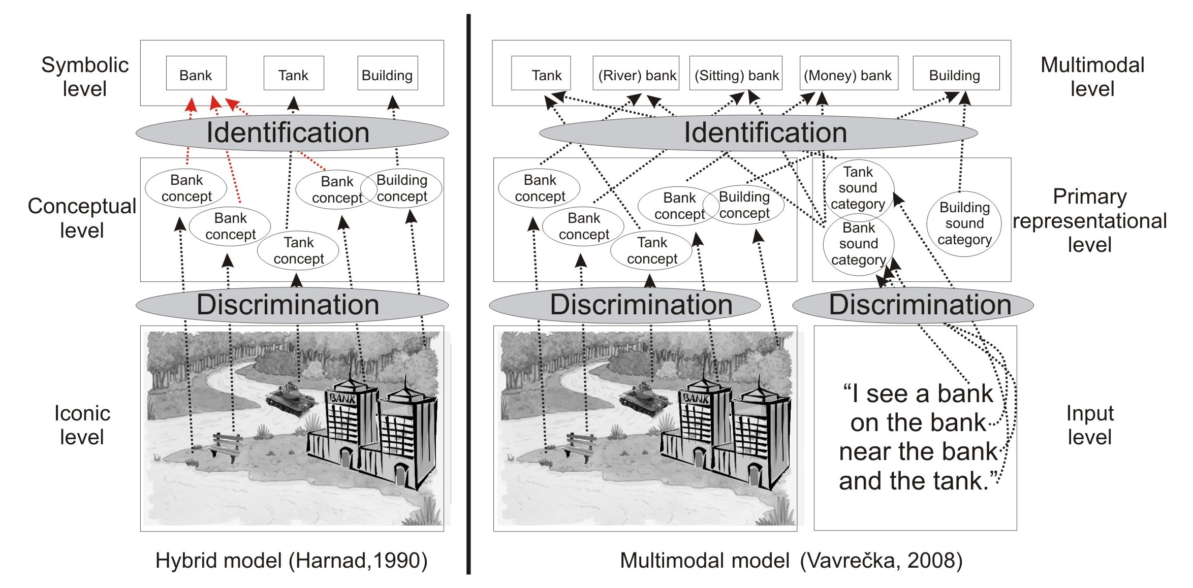
Unsupervised grounding (2008)
Notes:
5

Slide 6
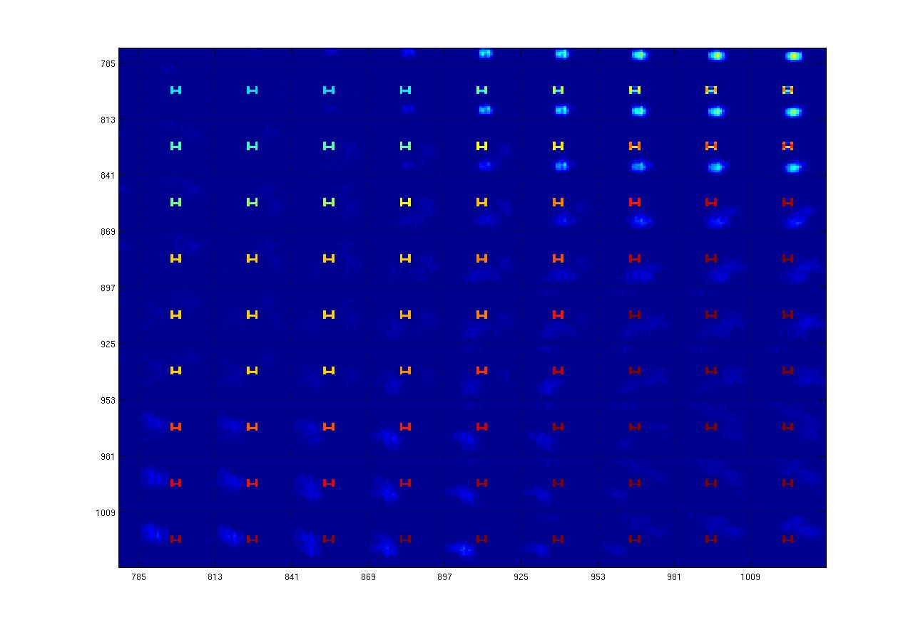
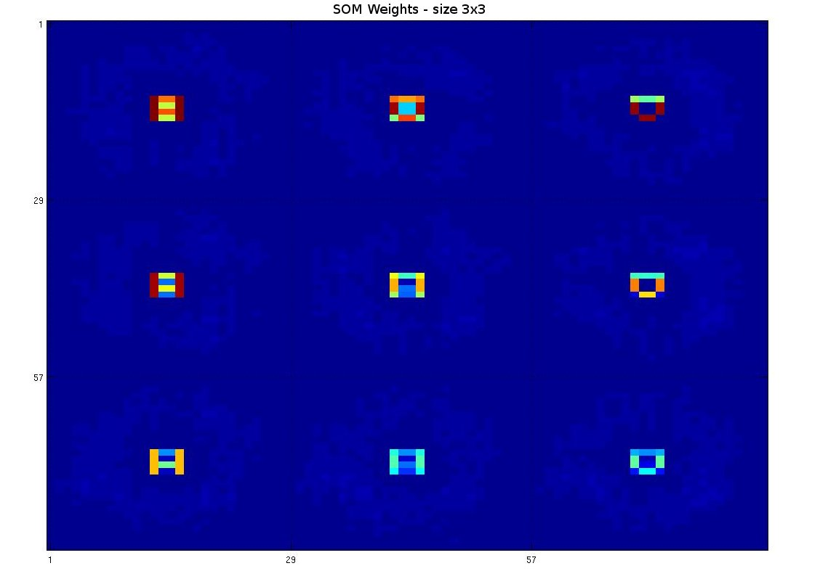
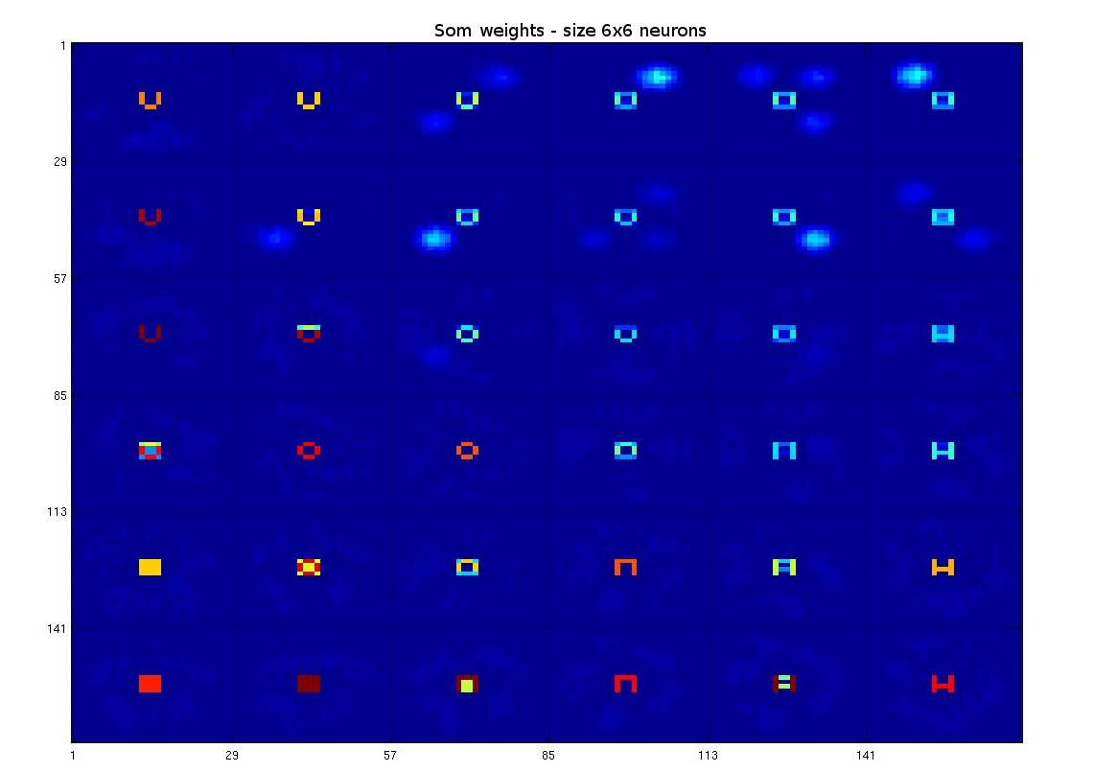
Primary representation
Notes:
6

Slide 7
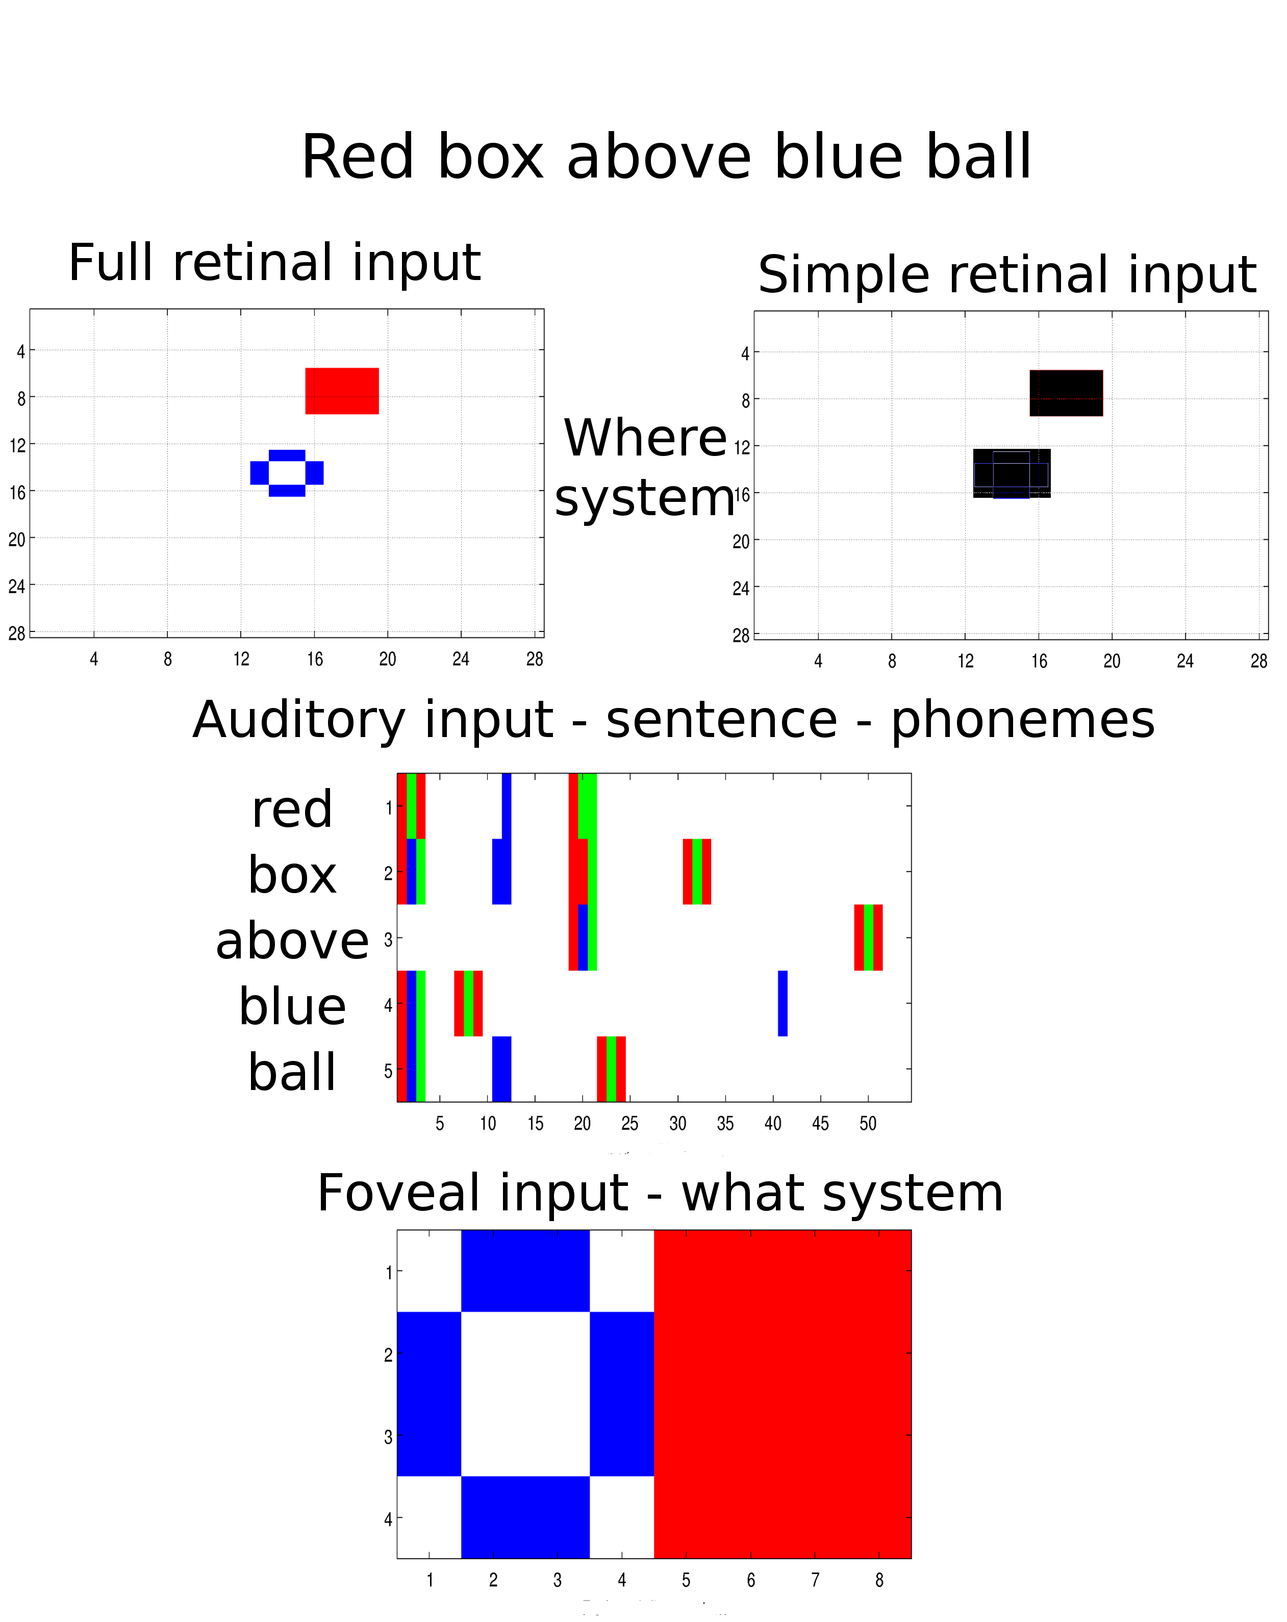
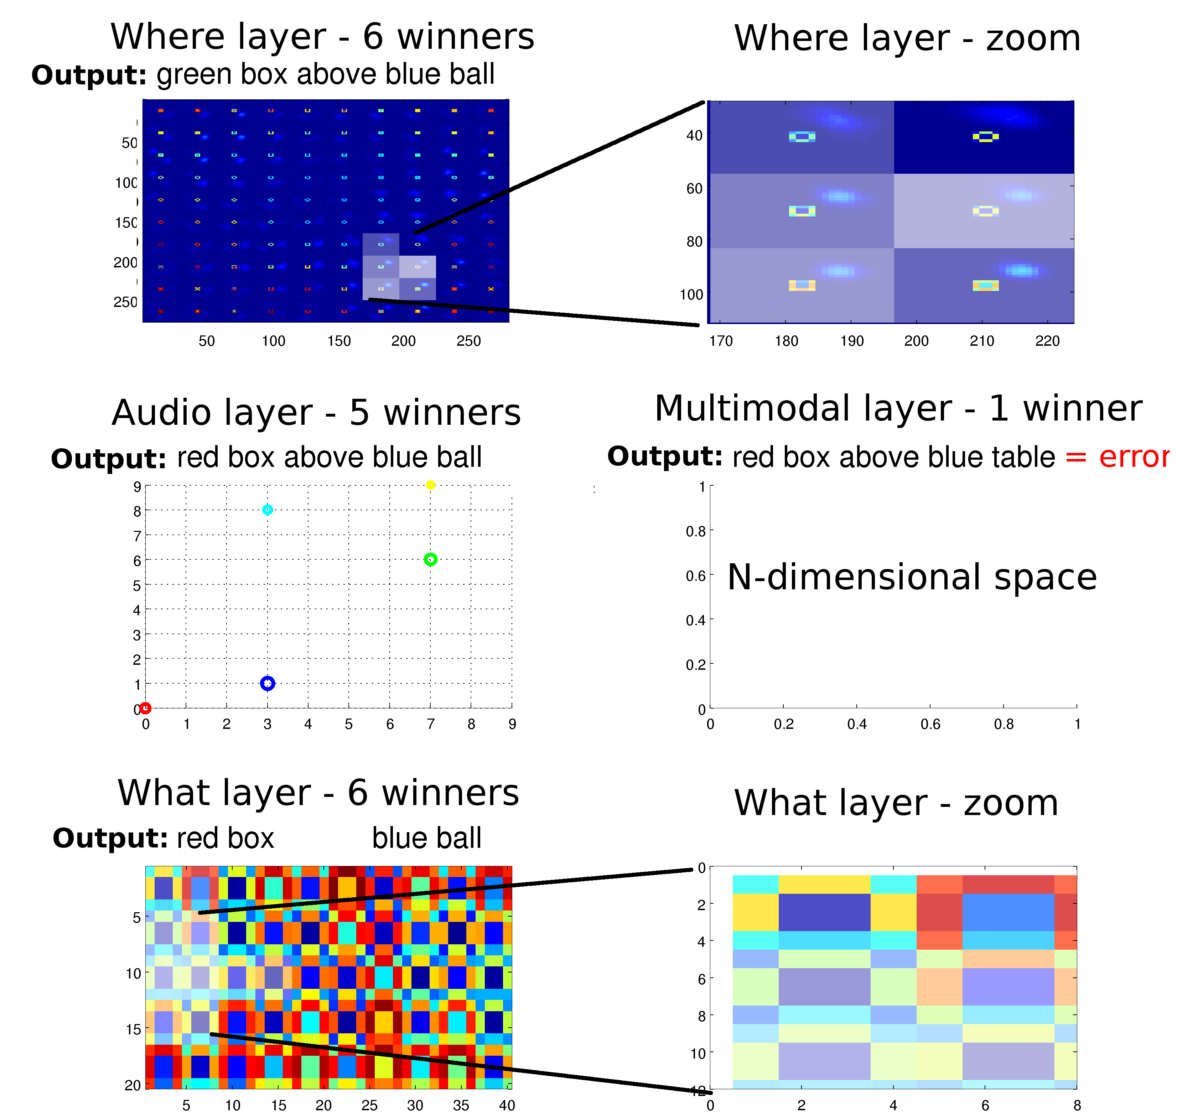
Separate vision modules (2009)
Notes:
7

Slide 8
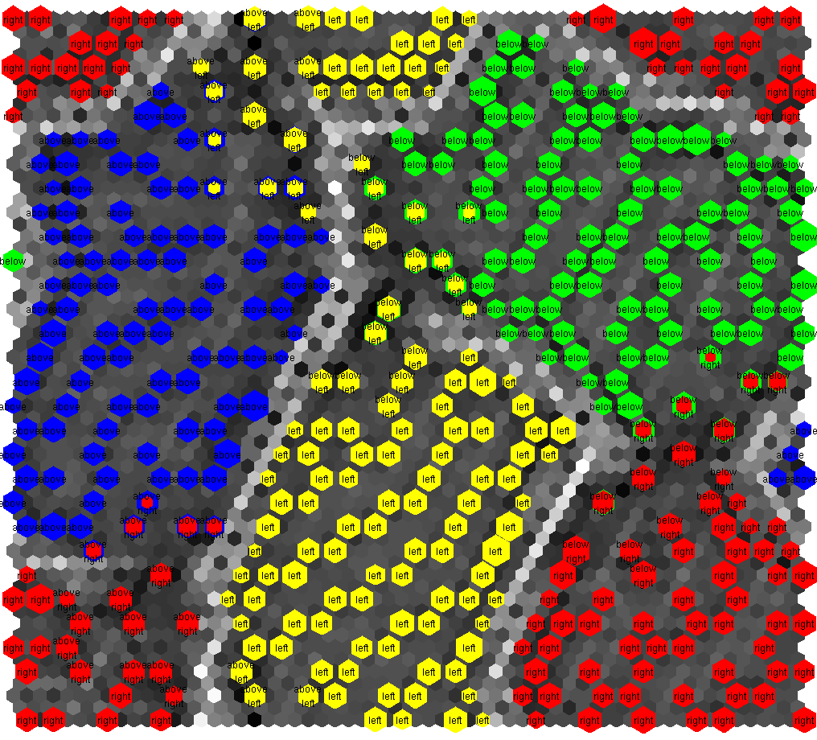
Where system (2009)
Notes:
8

Slide 9
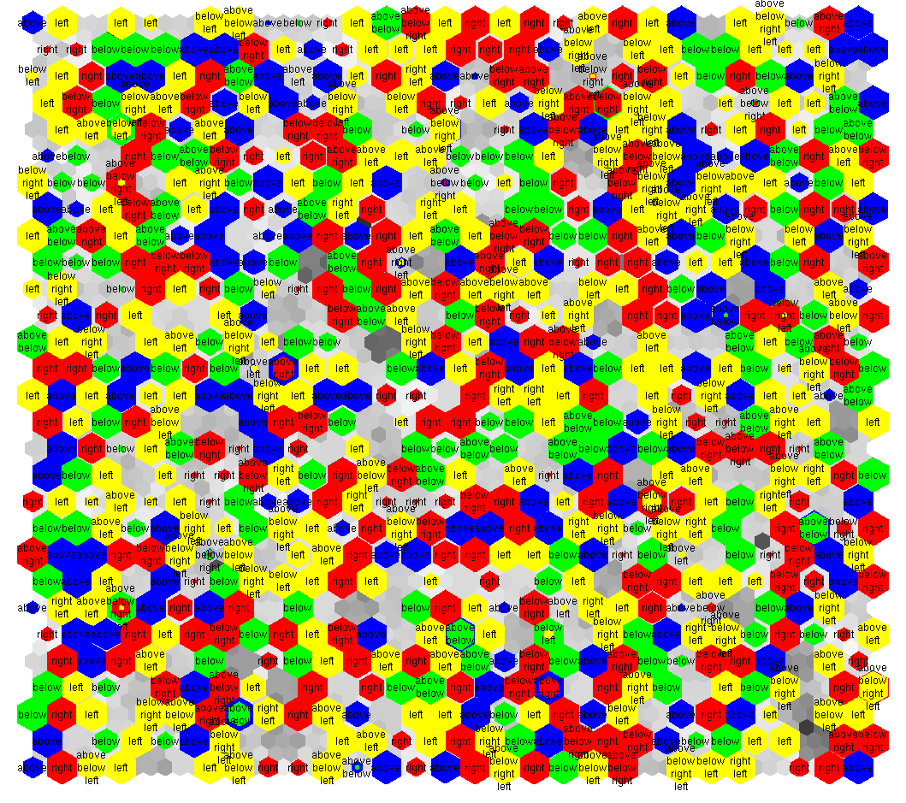
Multimodal representation
Notes:
9

Slide 10
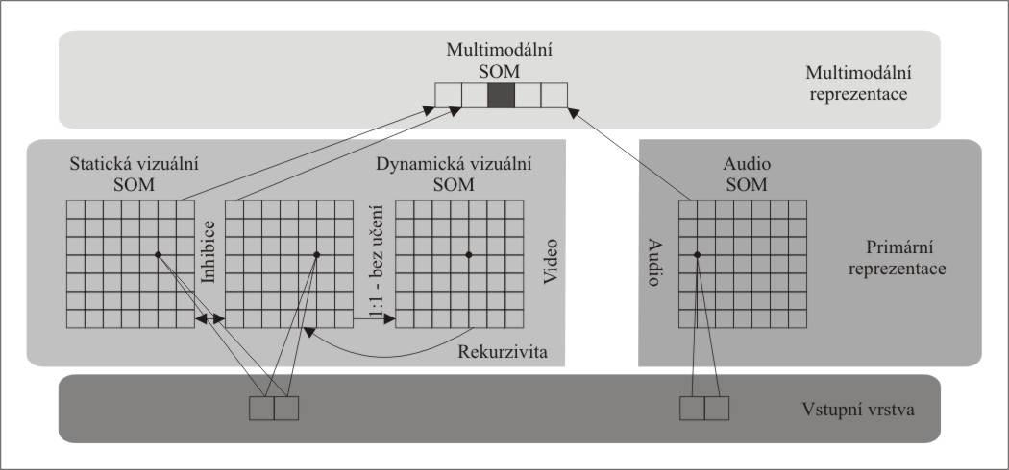
Sequence grounding (2011)

Slide 11
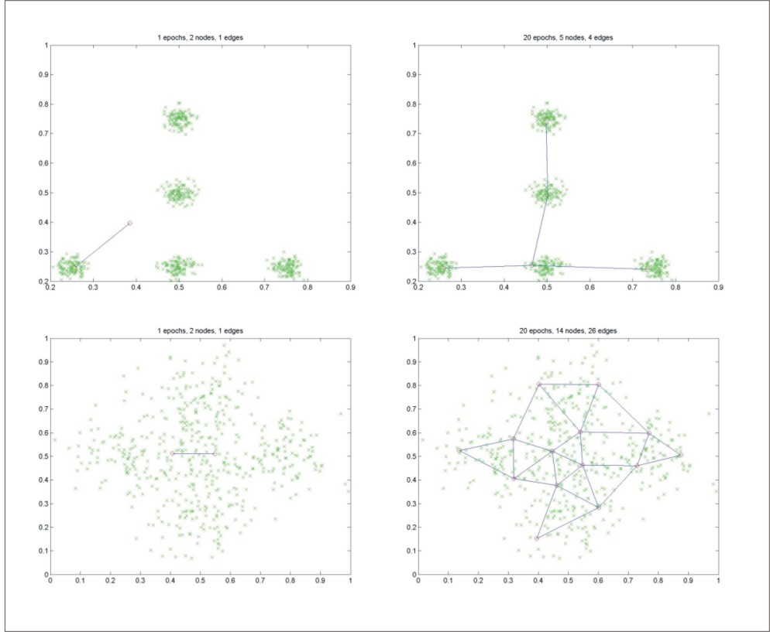
Growing nets (2012)

Slide 12
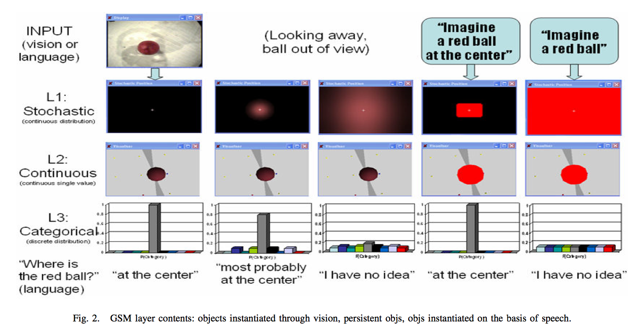
Ripley 2.0 (2013)
Notes:
12

Slide 13
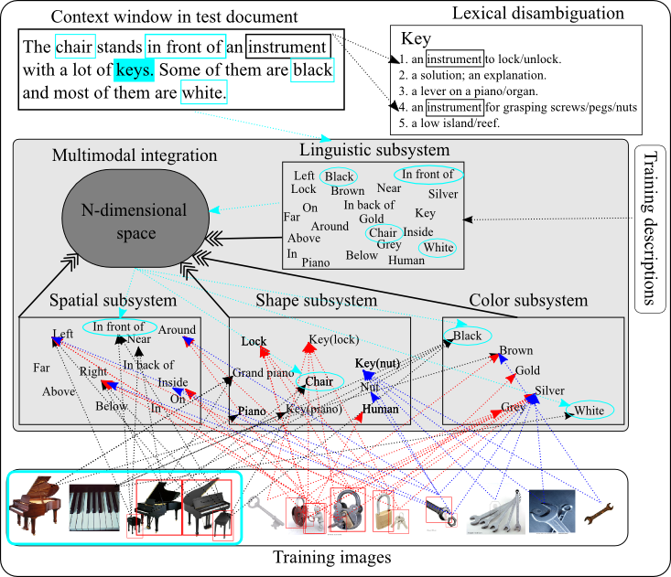
Disambiguation (2014)

Slide 14
Sentence grounding (2015)
Notes:
14

Slide 15
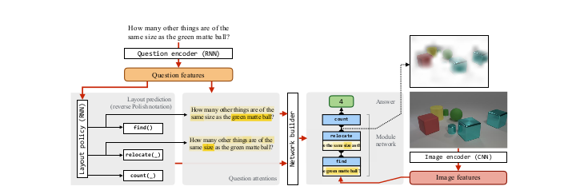
Neural module networks (2017)

Slide 16
Robotic question answering (2017)

Slide 17
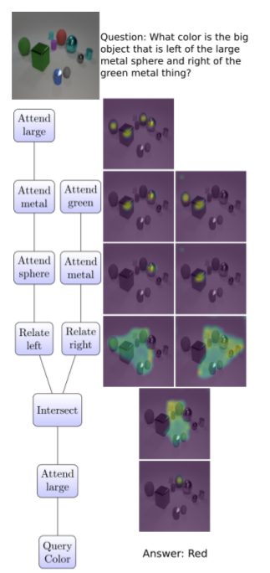
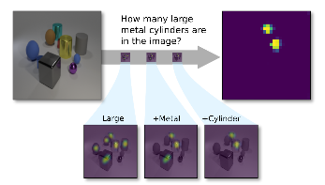
Transparency by design (2018)

Slide 18
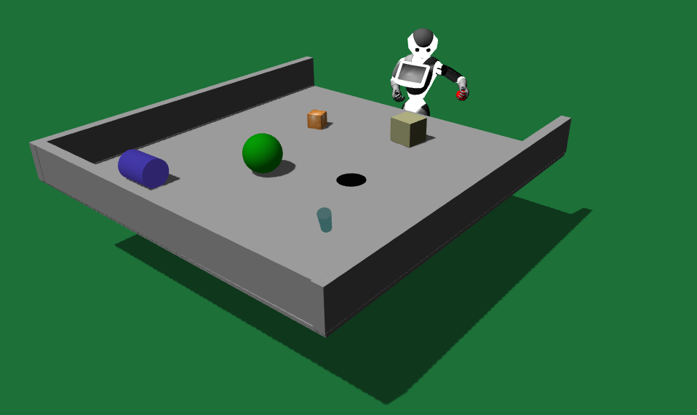
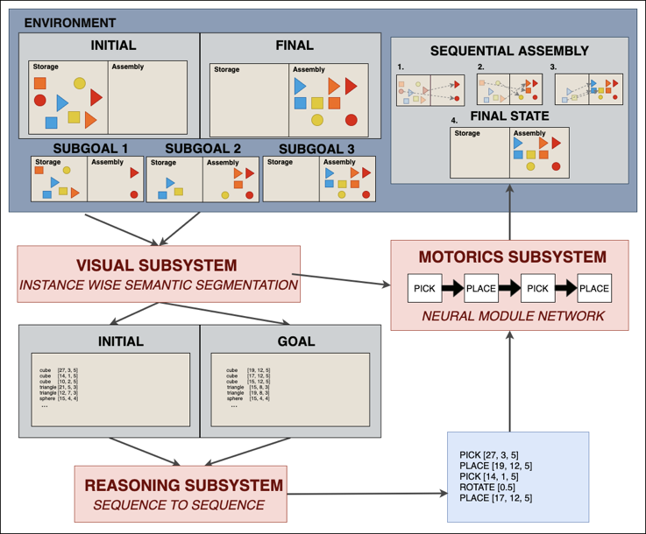
Verbal command execution (2019)

Slide 19
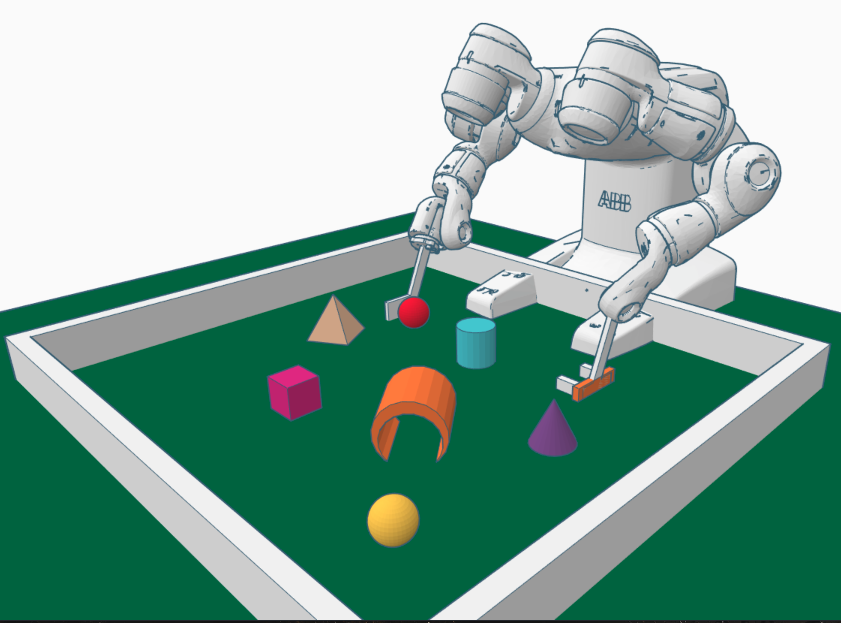
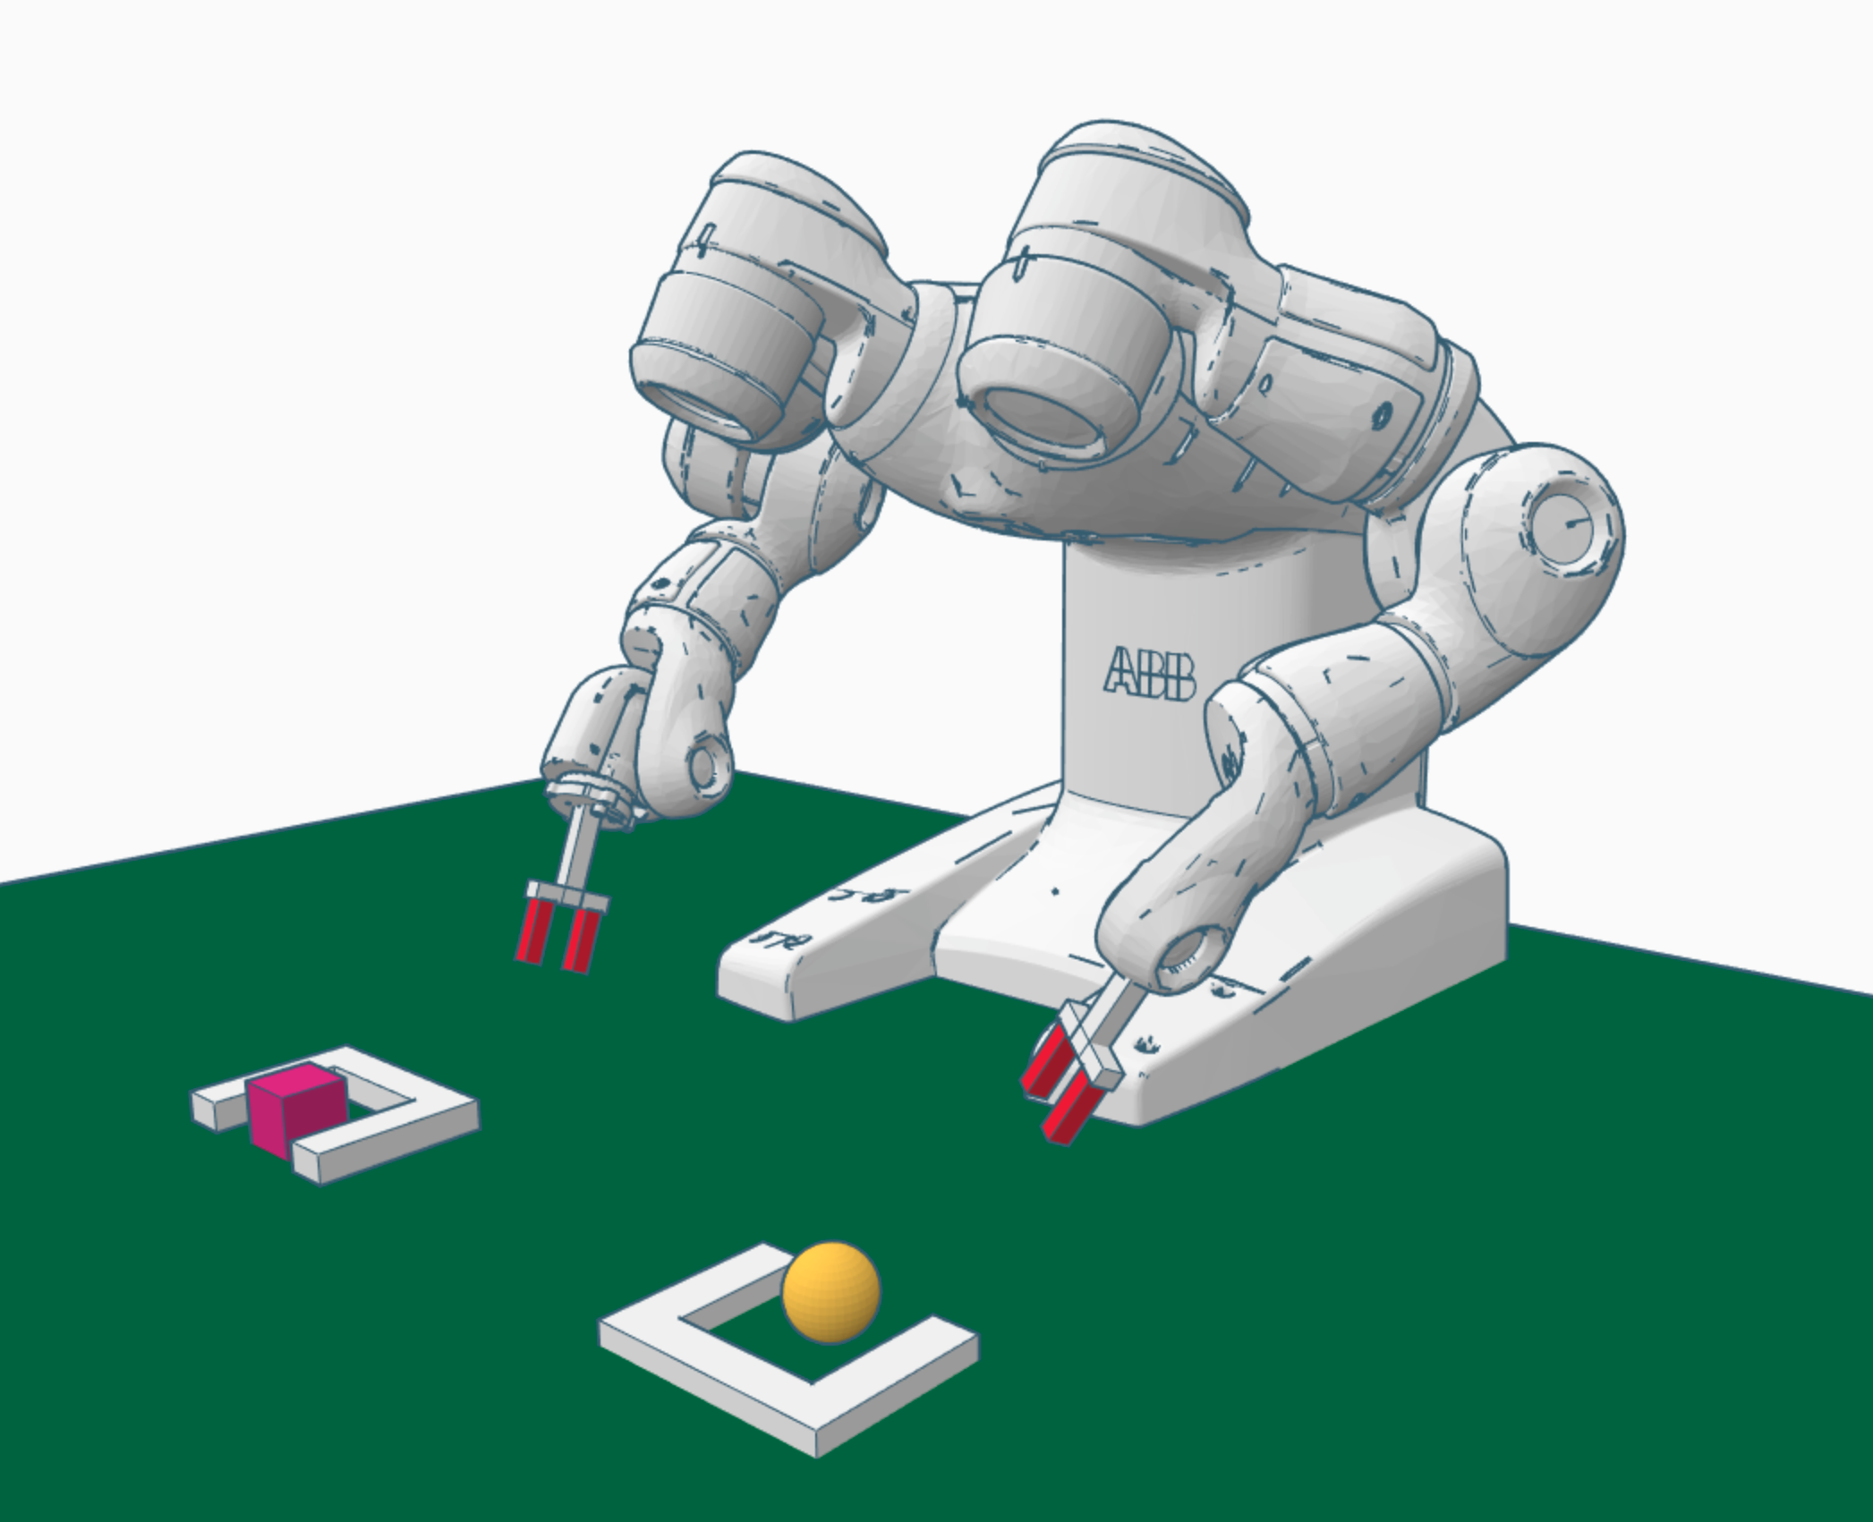
Intuitive physics (2020)

Slide 20
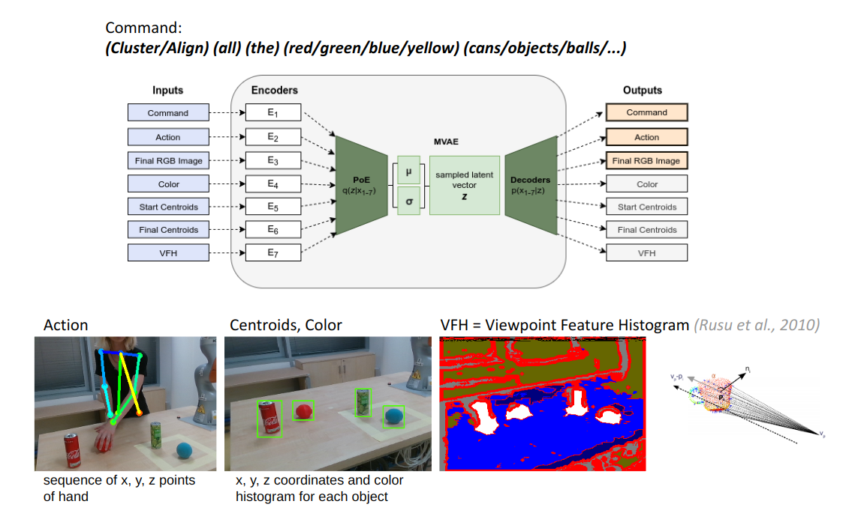
Multimodal autoencoders (2021)

Slide 21
Action grounding (2022)

Slide 22
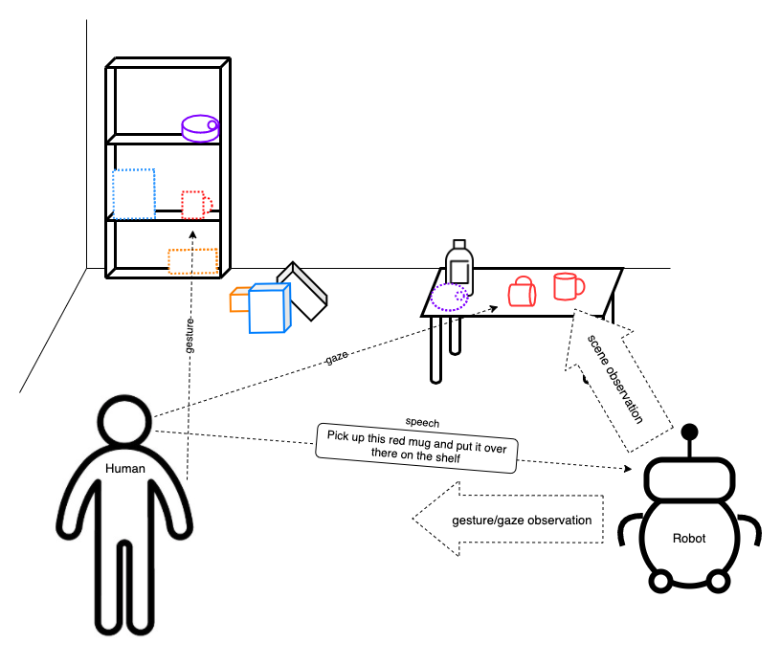
iChores project (2023-25)

Slide 23
Thank you
michal.vavrecka@cvut.cz
kognice.wixsite.com/vavrecka
incognite-lab.github.io
Notes:
23

