Slide 1
B4M36SAN
Anh Vu Le

Slide 2
I ♥ SAN
Linear regression
ANOVA
LDA
Dimensionality reduction
Clustering
toolbelt.jpg (1980×1320) (allstarinstallations.net)

Slide 3
Outline
Hands on R and Rstudio
Basic data structures in R
Basic data manipulation (Python has pandas, R has dplyr)
A few words about R
R vs Matlab Python

Slide 4
What is R?
Open-source statistical language and software environment .
Available freely under the GNU public license.
De facto standard for statistical research.
The core of R is an interpreted computer language.
Developed for the Unix-like, Windows and Mac families of operating systems.
R has a command line interface, but there are several graphical front-ends available (RStudio, RKWard, Rattle, Red-R, ...).

Slide 5
Why R?
Widely used among statisticians and data miners for developing statistical software and data analysis.
Many statistical procedures (linear and generalized linear models, nonlinear regression models, time series analysis, classical parametric and nonparametric tests, clustering and smoothing).
Very active community and package contributions (CRAN).
Very little programming language knowledge necessary
From Bo Cowgill’s introduction to R

Slide 6
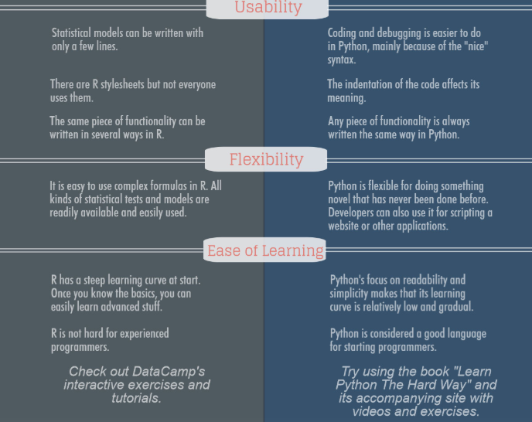
R vs Python
“ R makes it easy to try a lot of different ideas quickly. In Python, I would inevitably end up writing a bunch of generic code to solve this pretty narrow problem.”
https://www.stoodnt.com/blog/r-vs-python-metareview-usability-popularity-pros-cons-jobs-salaries/

Slide 7
R cheatsheets
https://rstudio.com/resources/cheatsheets/

Slide 8
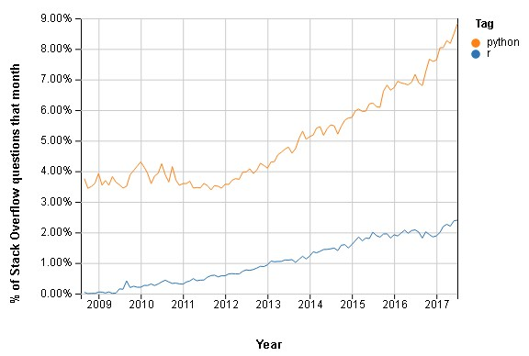
R vs Python
„R is not dying. It just grows slower“
https://www.stoodnt.com/blog/r-vs-python-metareview-usability-popularity-pros-cons-jobs-salaries/
https://www.zdnet.com/article/r-vs-python-rs-out-of-top-20-programming-languages-despite-boom-in-statistical-jobs/

Slide 9
Summary
What is the meaning of following symbols in R:
c()
.
<-
What is the difference between DataFrame, Vector and List?
What is the most essential package in R?
What are some functions from that package?
Is Python better than R?

