Slide 1
B4M36SAN Linear regression III
Anh Vu Le

Slide 2
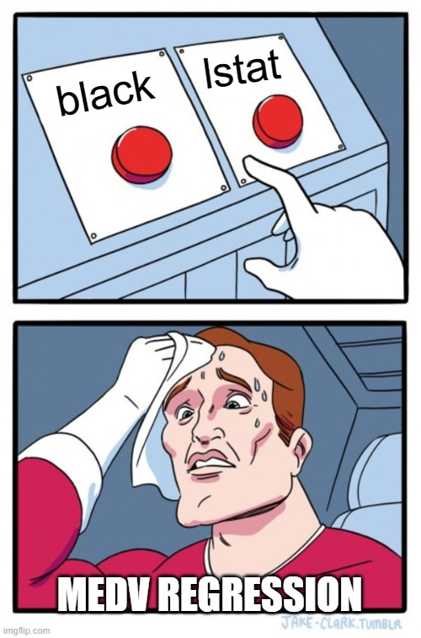
medv ~ black + lstat
Real model
Black does not affect prices
Correlates with lstat
$$β=−0.95 ∗∗∗∗$$
$$β=−0.45 ∗∗∗∗$$
(Multi)Collinearity
To be continued…

Slide 3
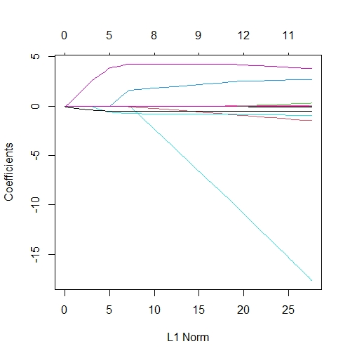
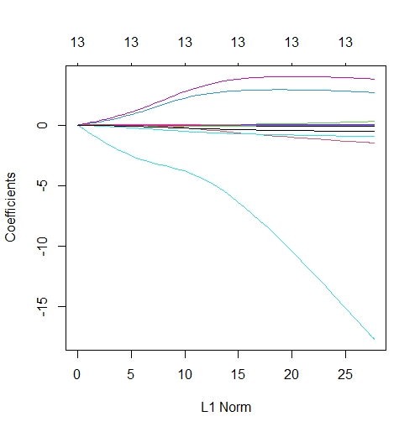
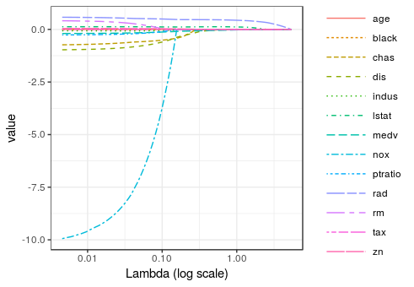
machine learning - R: Plotting lasso beta coefficients - Stack Overflow
https://xkcd.com/657/large/

Slide 4
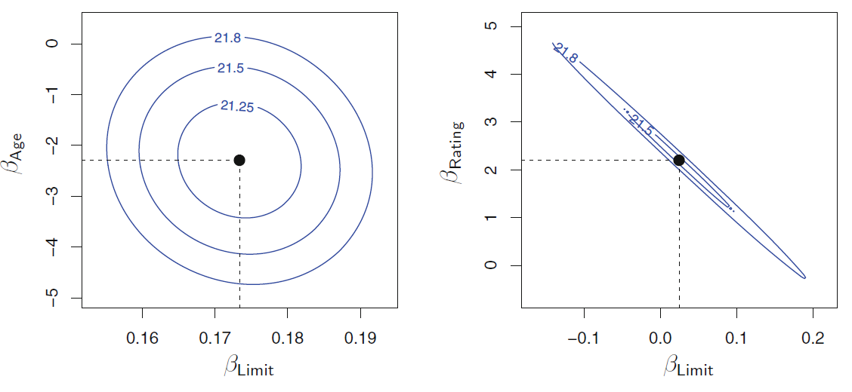
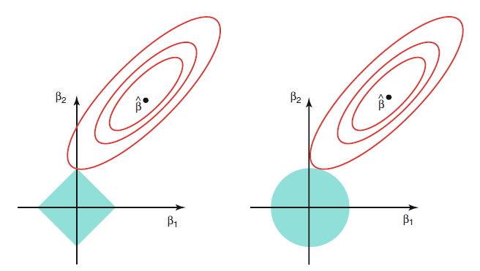
Previously on
(Multi)Collinearity
How ridge regression treats multi-collinearity
Driver.dvi (unica.it)

Slide 5
Summary
How coefficients of multiple regression differ in meaning from coefficients of simple regression
How Lasso performs feature selection?
What trade-off needs to be discussed?
What is multicollinearity and how it is manifested?
How does Ridge help to mitigate the issues?
What is the connection between splines and polynomial regression?
What are the differences?

