Slide 1
B4M36SAN ANOVA
Anh Vu Le

Slide 2
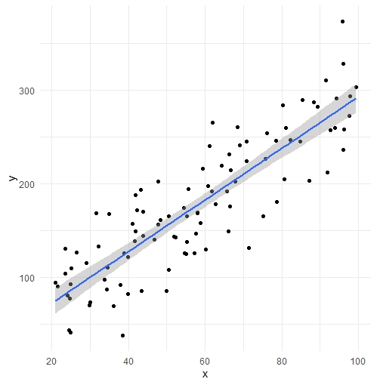
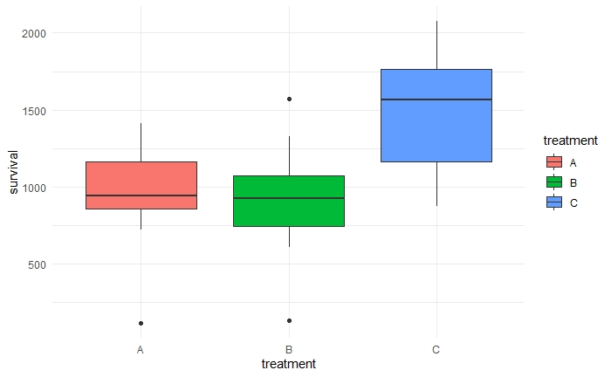
ANOVA - overview
Linear regression vs ANOVA:
is there a relationship?
predict
Quantitative variables
Quantitative response
is there a relationship?
Categorical variable
Quantitative response
Answers these types of questions:
Do study methods affect grades?
Are ratings of Interstellar the same on IMDb, Rotten Tomato and ČSFD?
Is any of the 5 treatments effective in extending patients life?
IMDb
RT
ČSFD

Slide 3
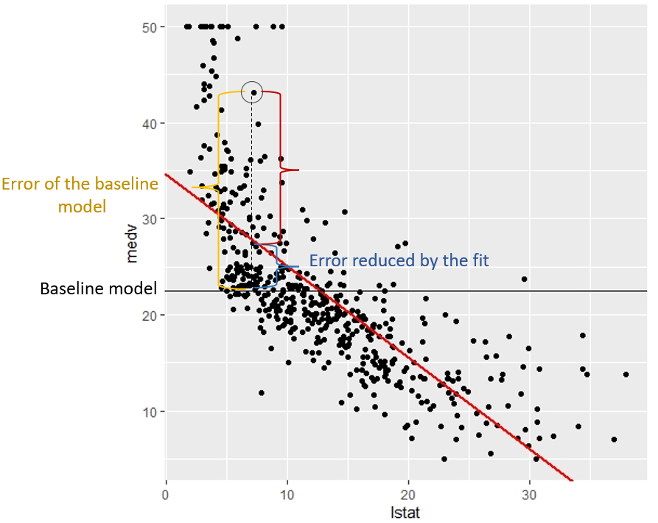
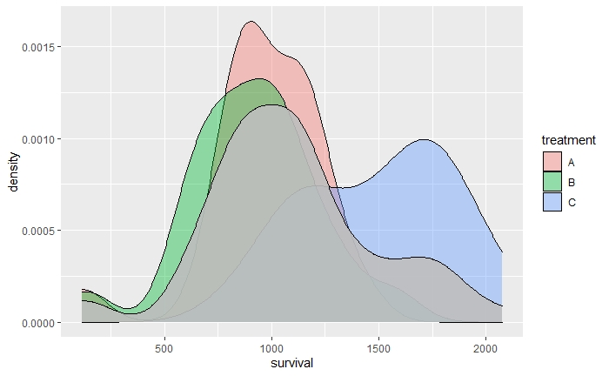
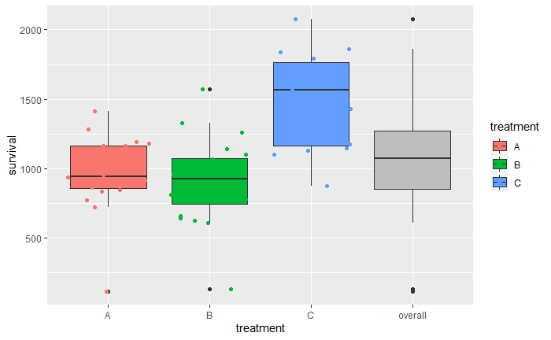
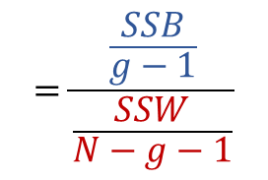

$$=\frac{\begin{aligned}Sum of squares \\ between\end{aligned}}{\begin{aligned}Sum of squares \\ within\end{aligned}}$$
$$=\frac{\frac{SSB}{g−1}}{\frac{SSW}{N−g−1}}$$
$$F=\frac{\begin{aligned}Variance explained \\ by the model\end{aligned}}{Variance unexplained}$$

Slide 4
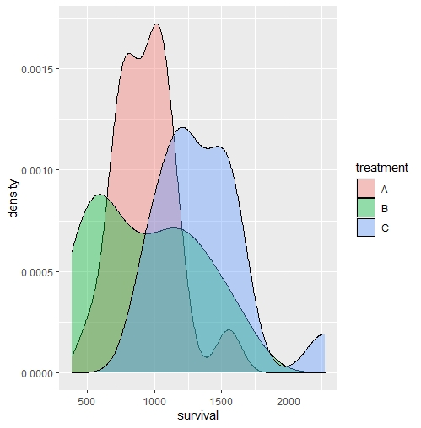
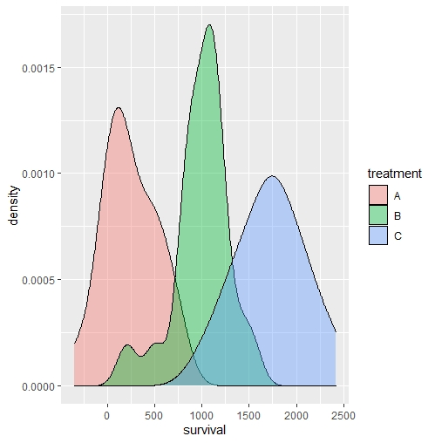
ANOVA formalism
Hypothesis testing
$$H_{0}: μ_{1}=μ_{2}=…=μ_{g}$$
$H_{A}: μ_{i}≠μ_{j} \text{for} \text{some} i≠j$
Assumptions
Samples are random and independent
The population of each factor group is normally distributed.
The population variances of each group are equal.

Slide 5
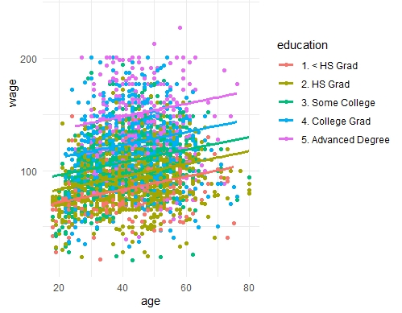
ANOVA in context
ANOVA vs Series of t-tests
ANOVA more powerful
ANOVA vs Linear regression
$$Y=β_{0}+β_{1}X_{1}+β_{2}X_{2}+ε$$
$$Salary=β_{0}+β_{1}age+β_{education_level_i}+ε$$
$$Y=μ+α_{i}+ε \text{for} \text{groups} 0<i<g$$
$$Survival=μ+α_{treatment_i}+ε \text{for} \text{treatment} 0<i<g$$

Slide 6
Linear regression
ANOVA
Perspective.jpg (720×576) (bp.blogspot.com)

