Slide 1
Combinatorial algorithms computing subset rank and unrank, Gray codes, $k$-element subset rank and unrank, computing permutation rank and unrank
Jiří Vyskočil, Radek Mařík
2012

Slide 2
Combinatorial Generation
definition:
Suppose that S is a finite set. A ranking function will be a bijection
rank: $S → \{0, … , |S|−1\}$
and unrank function is an inverse function to rank function.
definition:
Given a ranking function rank , defined on S, the successor function satisfies the following rule:
successor(s) = t ⇔ rank(t) = rank(s) + 1
potential uses:
storing combinatorial objects in the computer instead of storing a combinatorial structure which could be quite complicated
generation of random objects from S ensuring equal probability 1/|S|

Slide 3
Subsets
Suppose that $n$ is a positive integer and $S = \{1,…, n\}$.
Define $M$ to consist of the $2^{n}$ subsets of $S$.
Given a subset $T⊆S$ , let us define the characteristic vector of $T$ to be the one-dimensional binary array
$χ\left(T\right)=[x_{n−1},x_{n−2},…,x_{0}]$
where
$$x_{i}=\left\{\begin{matrix}1 & \text{if} (n−i)∈T \\ 0 & \text{if} (n−i)∉T\end{matrix}\right.$$

Slide 4
Subsets
Example of the lexicographic ordering on subsets of $S = \{1,2, 3\}$:
$$T$$ | $$χ\left(T\right)=[x_{2},x_{1},x_{0}]$$ | $$rank(T)$$
$$∅$$ | $$[0,0,0]$$ | $$0$$
$$\{3\}$$ | $$\left[0,0,1\right]$$ | $$1$$
$$\{2\}$$ | $$[0,1,0]$$ | $$2$$
$$\{2,3\}$$ | $$[0,1,1]$$ | $$3$$
$$\{1\}$$ | $$[1,0,0]$$ | $$4$$
$$\{1,3\}$$ | $$[1,0,1]$$ | $$5$$
$$\{1,2\}$$ | $$[1,1,0]$$ | $$6$$
$$\{1,2,3\}$$ | $$[1,1,1]$$ | $$7$$

Slide 5
Subsets
computing the subset rank over lexicographical ordering
Function SubsetLexRank( size n; set T ) : rank
r = 0 ;
for i = 1 to n do {
if i ∈ T then r = r + 2^{n-i} ;
}
return r ;
Function SubsetLexUnrank( size n; rank r ) : set
T = ∅ ;
for i = n downto 1 do {
if r mod 2 = 1 then T = T ∪ {i} ;
r = $r div 2$ ;
}
return T ;

Slide 6
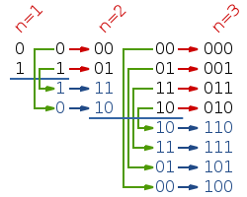
Gray Code
definition:
The reflected binary code, also known as Gray code, is a binary numeral system where two successive values differ in only one bit.
$G_{}^{n}$ will denote the reflected binary code for${ 2}^{n}$ binary n-tuples, and it will be written as a list of $2^{n}$ vectors $G_{i}^{n}$ , as follows:
$G_{}^{n}$=[$G_{0}^{n}$, $G_{1}^{n}$, … , $G_{2^{n}−1}^{n}$]
The codes $G_{}^{n}$ are defined recursively:
$G_{}^{1}$=[0,1]
$G_{}^{n}$=[${0G}_{0}^{n−1}$, ${0G}_{1}^{n−1}$, … ,${0G}_{2^{n−1}−1}^{n−1}{,1G}_{2^{n−1}−1}^{n−1}$, … ,${1G}_{1}^{n−1}$, ${1G}_{0}^{n−1}$]
example:
$G_{}^{3}$=[000, 001, 011, 010, 110, 111, 101, 100]

Slide 7
Gray Code
Example:
$$G_{r}^{3}$$ | $$r$$ | binary representation of $r$
$$000$$ | $$0$$ | $$000$$
$$001$$ | $$1$$ | $$001$$
$$011$$ | $$2$$ | $$010$$
$$010$$ | $$3$$ | $$011$$
$$110$$ | $$4$$ | $$100$$
$$111$$ | $$5$$ | $$101$$
$$101$$ | $$6$$ | $$110$$
$$100$$ | $$7$$ | $$111$$

Slide 8
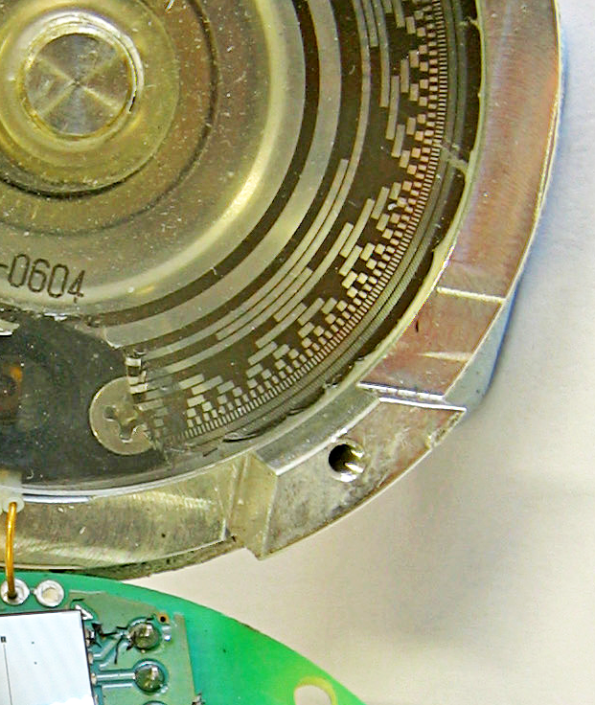
Gray Code
Rotary position encoder
Regardless of the care in aligning the contacts, and accuracy of the pattern, a natural-binary code would have errors at specific disk positions, because it is impossible to make all bits change at exactly the same time as the disk rotates. (...) Rotary encoders benefit from the cyclic nature of Gray codes, because consecutive positions of the sequence differ by only one bit.
https://en.wikipedia.org/wiki/Gray_code

Slide 9
Gray Code
lemma 1
Suppose
0 ≤ r ≤${ 2}^{n}−$1
B = b_{n−1} , … , b₀ is a binary code of r
G = g_{n−1} , … , g₀ is a Gray code of r
Then for every j ∈ {0,1, …, n – 1}
$g_{j}=\left(b_{j}+b_{j+1}\right) mod 2$
proof
By induction on n.
Note We may suppose b_{n} = g_{n} = 0.
Example:
$$G_{28}^{5}$$
10010
$$28$$
11100
0₀ = 0₀+0₁
1₁ = 1₁+0₂
0₂ = 1₂+1₃
0₃ = 1₃+1₄
1₄ = 1₄+0₅

Slide 10
Gray Code
lemma 2
Suppose
0 ≤ r ≤${ 2}^{n}−$1
B = b_{n−1} , … , b₀ is a binary code of r
G = g_{n−1} , … , g₀ is a Gray code of r
Then for every j ∈ {0,1, …, n – 1}
${ b}_{j}=\left(g_{j}+b_{j+1}\right) mod 2$
proof
$g_{j}=\left(b_{j}+b_{j+1}\right) mod 2⇒ g_{j}≡\left(b_{j}+b_{j+1}\right) (mod 2)$ $⇒$ $b_{j}≡\left(g_{j}+b_{j+1}\right) \left(mod 2\right)⇒ b_{j}=\left(g_{j}+b_{j+1}\right) mod 2$
Note We may suppose b_{n} = g_{n} = 0.
Example:
$$G_{28}^{5}$$
10010
$$28$$
11100
0₀ = 0₀+0₁
0₁ = 1₁+1₂
1₂ = 0₂+1₃
1₃ = 0₃+1₄
1₄ = 1₄+0₅

Slide 11
Gray Code
lemma 3
Suppose
0 ≤ r ≤${ 2}^{n}−$1
B = b_{n−1} , … , b₀ is a binary code of r
G = g_{n−1} , … , g₀ is a Gray code of r
Then for every j ∈ {0,1, …, n – 1}
proof
$$\left(\sum_{i=j}^{n−1}{g_{i}}\right)mod 2=\left(\sum_{i=j}^{n−1}{{(b}_{i}+b_{i+1})}\right)mod 2=\left(b_{j}+b_{n}+2\sum_{i=j+1}^{n−1}{b_{i}}\right)mod 2{=(b}_{j}+b_{n}) mod 2{=b}_{j}$$
Example:
$$G_{28}^{5}$$
10010
$$28$$
11100
0₀ = 0₀+1₁+0₂+0₃+1₄
0₁ = 1₁+0₂+0₃+1₄
1₂ = 0₂+0₃+1₄
1₃ = 0₃+1₄
1₄ = 1₄
$${ b}_{j}=\left(\sum_{i=j}^{n−1}{g_{i}}\right)mod 2$$
By lemma 1.
By the sum reordering.
By the property of modulo.
By the maximum range of r and the range of b_{j}.

Slide 12
Gray Code
converting to and from minimal change ordering (Gray code)
Function BinaryToGray( binary code rank B ) : gray code rank
return B xor (B >> 1) ;
Function GrayToBinary(gray code rank G ) : binary code rank
B = 0;
n = (number of bits in G) – 1;
for i=0 to n do {
B = B << 1;
B = B or (1 and ( (B >> 1) xor (G >> n) ) );
G = G << 1;
}
return B ;

Slide 13
Subsets – Gray Code
computing the subset rank over minimal change ordering
Set: $\{1,2, …, n\}$, using relation ${ b}_{j}=\left(g_{j}+b_{j+1}\right) mod 2$.
Function GrayCodeRank( size n; subset T ) : rank
r = 0 ;
b = 0 ;
for i = n – 1 downto 0 do {
if n – i ∈ T then b = 1 – b ;
if b = 1 then r = r + 2^{i} ;
}
return r ;
see also https://www.geeksforgeeks.org/gray-to-binary-and-binary-to-gray-conversion/

Slide 14
Subsets – Gray Code
computing the subset unrank over minimal change ordering
Function GrayCodeUnrank( size n; rank r ) : set
T = ∅ ;
c = 0 ;
for i = n – 1 downto 0 do {
b = $r div 2^{i}$ ;
if b ≠ c then T = T ∪ {n – i} ;
c = b ;
r = r – b$∙$2^{i} ;
}
return T ;

Slide 15
$k$ - Element subsets
Suppose that $n$ is a positive integer and $S = \{1,…, n\}$.
$\left(\begin{matrix}S \\ k\end{matrix}\right)$ consists of all $k\text{−}element subsets$of $S$.
A $k$-element subset $T⊆S$ can be represented in a natural way as a sorted one-dimensional array $\vec{T}=\left[t_{1},t_{2},…,t_{k}\right]$ where $t_{1}<t_{2}<…<t_{k}$ .

Slide 16
$k$ - Element subsets
Example of the lexicographic ordering on $k$-element subsets:
$$T$$ | $$\vec{T}$$ | $$rank(T)$$
$$\{1,2,3\}$$ | $$[1,2,3]$$ | $$0$$
$$\{1,2,4\}$$ | $$\left[1,2,4\right]$$ | $$1$$
$$\{1,2,5\}$$ | $$[1,2,5]$$ | $$2$$
$$\{1,3,4\}$$ | $$[1,3,4]$$ | $$3$$
$$\{1,3,5\}$$ | $$[1,3,5]$$ | $$4$$
$$\{1,4,5\}$$ | $$[1,4,5]$$ | $$5$$
$$\{2,3,4\}$$ | $$[2,3,4]$$ | $$6$$
$$\{2,3,5\}$$ | $$[2,3,5]$$ | $$7$$
$$\{2,4,5\}$$ | $$[2,4,5]$$ | $$8$$
$$\{3,4,5\}$$ | $$[3,4,5]$$ | $$9$$

Slide 17
$k$ - Element subsets
computing the $k$-element subset successor with lexicographic ordering
Function kSubsetLexSuccesor(k-element subset as array T;
number n, k ) : k-element subset as array ;
U = T ;
i = k ;
while ( i ≥ 1 ) and ( T[i] = n – k + i ) do i = i – 1 ;
if ( i = 0 ) then
return “undefined” ;
else {
for j = i to k do U[j] = T[i] + 1 + j – i ;
return U ;
}

Slide 18
$k$ - Element subsets
computing the $k$-element subset rank with lexicographic ordering
Function kSubsetLexRank(k-element subset as array T;
number n, k ) : rank ;
r = 0 ;
T[0] = 0 ;
for i = 1 to k do {
if ( T[i$−$1]+1 ≤ T[i]$−$1 ) then {
for j = T[i$−$1]+1 to T[i]$−$1 do r = r + $\left(\begin{matrix}n−j \\ k−i\end{matrix}\right)$ ;
}
}
return r ;

Slide 19
$k$ - Element subsets
computing the $k$-element subset unrank with lexicographic ordering
Function kSubsetLexUnrank(rank r;
number n, k ) : k-element subset as array ;
x = 1 ;
for i = 1 to k do {
while ( $\left(\begin{matrix}n−x \\ k−i\end{matrix}\right)$≤ r ) do {
r = r $−$ $\left(\begin{matrix}n−x \\ k−i\end{matrix}\right)$ ;
x = x + 1 ;
}
T[i] = x ;
x = x + 1 ;
}
return T ;

Slide 20
Permutations
A permutation is a bijection from a set to itself.
one possible representation of a permutation
$π:\left\{1,…,n\right\}→\left\{1,…,n\right\}$
is by storing its values in a one-dimensional array as follows:
index | 1 | 2 | … | n
value | $π$[1] | $π$[2] | … | $π$[n]

Slide 21
Permutations
computing the permutation rank over lexicographical ordering
Function PermLexRank( size n; permutation π ) : rank
r = 0 ;
ρ = π ;
for j = 1 to n do {
r = r + (ρ[ j ] – 1)∙(n – j)! ;
for i = j +1 to n do if ρ[ i ] > ρ[ j ] then ρ[ i ] = ρ[ i ] – 1 ;
}
return r ;

Slide 22
Permutations
computing the permutation unrank over lexicographical ordering
Function PermLexUnRank( size n; rank r ) : permutation
π[ n ] = 1 ;
for j = 1 to n – 1 do {
d = $\frac{r mod \left(j+1\right)!}{j!}$ ;
r = r – d ∙ j! ;
π[ n – j ] = d + 1 ;
for i = n – j + 1 to n do if π[ i ] > d then π[ i ] = π[ i ] + 1 ;
}
return π ;

Slide 23
References
D.L. Kreher and D.R. Stinson , Combinatorial Algorithms: Generation, Enumeration and Search , CRC press LTC , Boca Raton, Florida, 1998.

