Slide 1
Text Search
~
k
Dictionary NFA and text search
A
R
Dictionary DFA and text search
B
n
f
Hamming distance and Dynamic Programming?
Levenshtein distance and Dynamic Programming
u
j
Resume
Boyer-Moore text search approach
k
!
N
@#
e
Literature:
Borivoj Melichar, Jan Holub, Tomas Polcar
TEXT SEARCHING ALGORITHMS VOLUME I.
CTU, FEE, Nov 2005
Pokročilá Algoritmizace, A4M33PAL, ZS 2009/2010, FEL ČVUT, 7/12

Slide 2
Finite language
Is a dictionary
1
Dictionary over an alphabet A is a finite set of strings (patterns) from A*.
Dictionary automaton searches the text for any pattern in the given dictionary.
Recycle older knowledge
1. Dictionary is a finite language.
2. Each finite language is a regular language.
3. Each regular language can be described by a regular expression.
4. Any language described by a regular expression can be searched for
in any text using appropriate NFA/DFA.
Example
Alphabet
A = {a, c, d, e, g, h, i, l, m, n, o, q, r, s, t, u, v, y}
Dictionary
D = {"add", "advanced", "algorithms", "to", "your", "algonqiuan", "adventures"}
The Algonquian are one of the most populous and widespread North American native language groups.

Slide 3
Finite language
Building Automaton
2
Merge repeatedly into a single state any two states A and B such that path
from S to A and from S to B are of equal length and contain equal sequence
of transition labels. You may find e.g. BFS/DFS to be useful.
a
d
d
a
d
v
a
n
c
e
d
a
l
g
o
r
i
t
h
m
s
S
t
o
y
o
u
r
a
l
g
o
n
g
u
i
a
n
a
d
v
e
n
t
u
r
e
s

Slide 4
Finite language
Building Automaton
3
d
d
d
v
a
n
c
e
d
a
l
g
o
r
i
t
h
m
s
S
l
g
o
n
g
u
i
a
n
d
v
e
n
t
u
r
e
s
t
o
y
o
u
r

Slide 5
Finite language
Building Automaton
4
d
d
v
a
n
c
e
d
a
v
e
n
t
u
r
e
s
S
l
g
o
r
i
t
h
m
s
g
o
n
g
u
i
a
n
t
o
y
o
u
r

Slide 6
Finite language
Building Automaton
5
d
d
v
a
n
c
e
d
a
e
n
t
u
r
e
s
S
l
g
o
r
i
t
h
m
s
o
n
g
u
i
a
n
t
o
y
o
u
r

Slide 7
Finite language
Building Automaton
6
d
d
v
a
n
c
e
d
a
e
n
t
u
r
e
s
S
l
g
o
r
i
t
h
m
s
n
g
u
i
a
n
t
o
y
o
u
r

Slide 8
Dictionary NFA
Automaton
7
Search NFA for dictionary
D = {"add", "advanced", "algorithms", "to", "your", "algonqiuan", "adventures"}
3
d
A₁
v
a
n
c
e
d
2
4
5
6
7
8
9
d
e
n
t
u
r
e
s
Σ
1
10
11
12
13
14
15
16
a
l
g
o
r
i
t
h
m
s
0
17
18
19
20
21
22
23
24
25
n
q
u
i
a
n
t
26
27
28
29
30
31
o
32
33
y
o
u
r
34
35
36
37

Slide 9
Small Optimization
In Fact Unnecessary
8
d
v
a
n
c
e
d
Σ
a
Optionally, identical suffixes
can be merged too, but it is not
necessary as effectivity will be granted
on the next slide.
S
S
Anyway, be careful.
Σ
S
S
This is a wrong construction.
It would incorrectly add
word "tour" to the dictionary.
t
y
o
u
r

Slide 10
Dictionary DFA
Favourably Sized
9
The transition diagram of a dictionary NFA, like A₁ in the previous example,
is a directed tree with the start state in the root.
The only loop is the self-loop in the start state labeled by the whole alpahbet.
This NFA has an usefull property:
Effectivity
Transforming dictionary NFA of this shape to DFA
does not increase the number of states.
Example
The transition diagram of the resulting DFA has 38 states (same as NFA)
and 684 transitions. It would not fit nicely into one slide, therefore
we present only the transition table... :
Homework: Draw it!

Slide 11
Dictionary DFA
Example Part 1
10
 | a | c | d | e | g | h | i | l | m | n | o | q | r | s | t | u | v | y
0 | 0,1 | 0 | 0 | 0 | 0 | 0 | 0 | 0 | 0 | 0 | 0 | 0 | 0 | 0 | 0,32 | 0 | 0 | 0,34
0,1 | 0,1 | 0 | 0,2 | 0 | 0 | 0 | 0 | 0,17 | 0 | 0 | 0 | 0 | 0 | 0 | 0,32 | 0 | 0 | 0,34
0,32 | 0,1 | 0 | 0 | 0 | 0 | 0 | 0 | 0 | 0 | 0 | 0,33 | 0 | 0 | 0 | 0,32 | 0 | 0 | 0,34
0,34 | 0,1 | 0 | 0 | 0 | 0 | 0 | 0 | 0 | 0 | 0,35 | 0 | 0 | 0 | 0 | 0,32 | 0 | 0 | 0,34
0,2 | 0,1 | 0 | 0,3 | 0 | 0 | 0 | 0 | 0 | 0 | 0 | 0 | 0 | 0 | 0 | 0,32 | 0 | 0,4 | 0,34
0,17 | 0,1 | 0 | 0 | 0 | 0 | 0 | 0 | 0 | 0 | 0 | 0 | 0 | 0 | 0 | 0,32 | 0 | 0 | 0,34
0,33 | 0,1 | 0 | 0 | 0 | 0 | 0 | 0 | 0 | 0 | 0 | 0 | 0 | 0 | 0 | 0,32 | 0 | 0 | 0,34 | F
0,35 | 0,1 | 0 | 0 | 0 | 0 | 0 | 0 | 0 | 0 | 0 | 0 | 0 | 0 | 0 | 0,32 | 0,36 | 0 | 0,34
0,3 | 0,1 | 0 | 0 | 0 | 0 | 0 | 0 | 0 | 0 | 0 | 0 | 0 | 0 | 0 | 0,32 | 0 | 0 | 0,34 | F
0,4 | 0,1,5 | 0 | 0 | 0 | 0 | 0 | 0 | 0 | 0 | 0 | 0 | 0 | 0 | 0 | 0,32 | 0 | 0 | 0,34
0,18 | 0,1 | 0 | 0 | 0 | 0 | 0 | 0 | 0 | 0 | 0 | 0,19 | 0 | 0 | 0 | 0,32 | 0 | 0 | 0,34
0,36 | 0,1 | 0 | 0 | 0 | 0 | 0 | 0 | 0 | 0 | 0 | 0 | 0 | 0,37 | 0 | 0,32 | 0 | 0 | 0,34
0,1,5 | 0,1 | 0 | 0 | 0,2 | 0 | 0 | 0 | 0,17 | 0 | 0,6 | 0 | 0 | 0 | 0 | 0,32 | 0 | 0 | 0,34
Transition table of DFA A₂ equivalent to dictionary NFA A₁.
Continue...

Slide 12
Dictionary DFA
Example Part 2
11
... continued
 | a | c | d | e | g | h | i | l | m | n | o | q | r | s | t | u | v | y
0,10 | 0,1 | 0 | 0 | 0 | 0 | 0 | 0 | 0 | 0 | 0,11 | 0 | 0 | 0 | 0 | 0,32 | 0 | 0 | 0,34
0,19 | 0,1 | 0 | 0 | 0 | 0 | 0 | 0 | 0 | 0 | 0,26 | 0 | 0 | 0,20 | 0 | 0,32 | 0 | 0 | 0,34
0,37 | 0,1 | 0 | 0 | 0 | 0 | 0 | 0 | 0 | 0 | 0 | 0 | 0 | 0 | 0 | 0,32 | 0 | 0 | 0,34 | F
0,6 | 0,1 | 0,7 | 0 | 0 | 0 | 0 | 0 | 0 | 0 | 0 | 0 | 0 | 0 | 0 | 0,32 | 0 | 0 | 0,34
0,11 | 0,1 | 0 | 0 | 0 | 0 | 0 | 0 | 0 | 0 | 0 | 0 | 0 | 0 | 0 | 0,12,32 | 0 | 0 | 0,34
0,26 | 0,1 | 0 | 0 | 0 | 0 | 0 | 0 | 0 | 0 | 0 | 0 | 0,27 | 0 | 0 | 0,32 | 0 | 0 | 0,34
0,20 | 0,1 | 0 | 0 | 0 | 0 | 0 | 0,21 | 0 | 0 | 0 | 0 | 0 | 0 | 0 | 0,32 | 0 | 0 | 0,34
0,7 | 0,1 | 0 | 0 | 0,8 | 0 | 0 | 0 | 0 | 0 | 0 | 0 | 0 | 0 | 0 | 0,32 | 0 | 0 | 0,34
0,12,32 | 0,1 | 0 | 0 | 0 | 0 | 0 | 0 | 0 | 0 | 0 | 0,33 | 0 | 0 | 0 | 0,32 | 0,13 | 0 | 0,34
0,27 | 0,1 | 0 | 0 | 0 | 0 | 0 | 0 | 0 | 0 | 0 | 0 | 0 | 0 | 0 | 0,32 | 0,28 | 0 | 0,34
0,21 | 0,1 | 0 | 0 | 0 | 0 | 0 | 0 | 0 | 0 | 0 | 0 | 0 | 0 | 0 | 0,22,32 | 0 | 0 | 0,34
0,8 | 0,1 | 0 | 0,9 | 0 | 0 | 0 | 0 | 0 | 0 | 0 | 0 | 0 | 0 | 0 | 0,32 | 0 | 0 | 0,34
0,13 | 0,1 | 0 | 0 | 0 | 0 | 0 | 0 | 0 | 0 | 0 | 0 | 0 | 0,14 | 0 | 0,32 | 0 | 0 | 0,34
continue...

Slide 13
Dictionary DFA
Example Part 3
12
... continued
 | a | c | d | e | g | h | i | l | m | n | o | q | r | s | t | u | v | y
0,28 | 0,1 | 0 | 0 | 0 | 0 | 0 | 0,29 | 0 | 0 | 0 | 0 | 0 | 0 | 0 | 0,32 | 0 | 0 | 0,34
0,22,32 | 0,1 | 0 | 0 | 0 | 0 | 0,23 | 0 | 0 | 0 | 0 | 0,33 | 0 | 0 | 0 | 0,32 | 0 | 0 | 0,34
0,9 | 0,1 | 0 | 0 | 0 | 0 | 0 | 0 | 0 | 0 | 0 | 0 | 0 | 0 | 0 | 0,32 | 0 | 0 | 0,34 | F
0,14 | 0,1 | 0 | 0 | 0,15 | 0 | 0 | 0 | 0 | 0 | 0 | 0 | 0 | 0 | 0 | 0,32 | 0 | 0 | 0,34
0,23 | 0,1 | 0 | 0 | 0 | 0 | 0 | 0 | 0 | 0,24 | 0 | 0 | 0 | 0 | 0 | 0,32 | 0 | 0 | 0,34
0,29 | 0,1, 30 | 0 | 0 | 0 | 0 | 0 | 0 | 0 | 0 | 0 | 0 | 0 | 0 | 0 | 0,32 | 0 | 0 | 0,34
0,15 | 0,1 | 0 | 0 | 0 | 0 | 0 | 0 | 0 | 0 | 0 | 0 | 0 | 0 | 0,16 | 0,32 | 0 | 0 | 0,34
0,24 | 0,1 | 0 | 0 | 0 | 0 | 0 | 0 | 0 | 0 | 0 | 0 | 0 | 0 | 0,25 | 0,32 | 0 | 0 | 0,34
0,1, 30 | 0,1 | 0 | 0,2 | 0 | 0 | 0 | 0 | 0,17 | 0 | 0,31 | 0 | 0 | 0 | 0 | 0,32 | 0 | 0 | 0,34
0,16 | 0,1 | 0 | 0 | 0 | 0 | 0 | 0 | 0 | 0 | 0 | 0 | 0 | 0 | 0 | 0,32 | 0 | 0 | 0,34 | F
0,25 | 0,1 | 0 | 0 | 0 | 0 | 0 | 0 | 0 | 0 | 0 | 0 | 0 | 0 | 0 | 0,32 | 0 | 0 | 0,34 | F
0,31 | 0,1 | 0 | 0 | 0 | 0 | 0 | 0 | 0 | 0 | 0 | 0 | 0 | 0 | 0 | 0,32 | 0 | 0 | 0,34 | F
... finished.

Slide 14
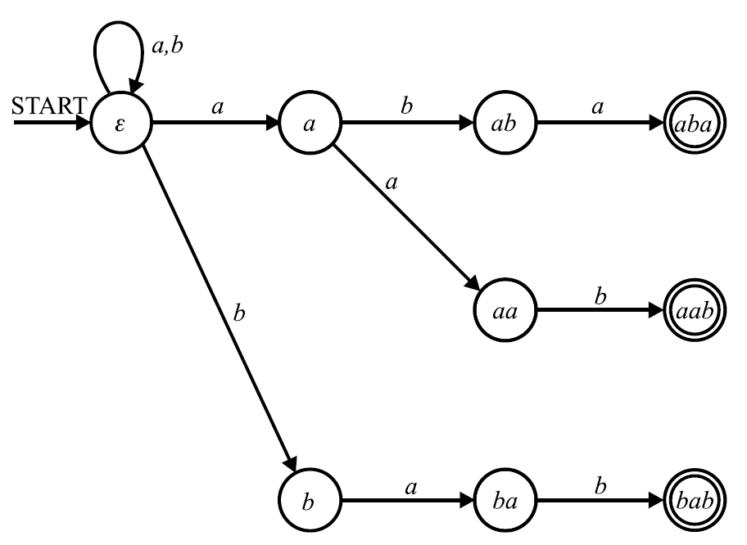
Dictionary DFA
Tiny Example
13
Example of a dictionary automaton whose transition diagram fits to one slide.
NFA
Alphabet = {a, b}
Dictionary = {"aba", "aab", "bab"}

Slide 15
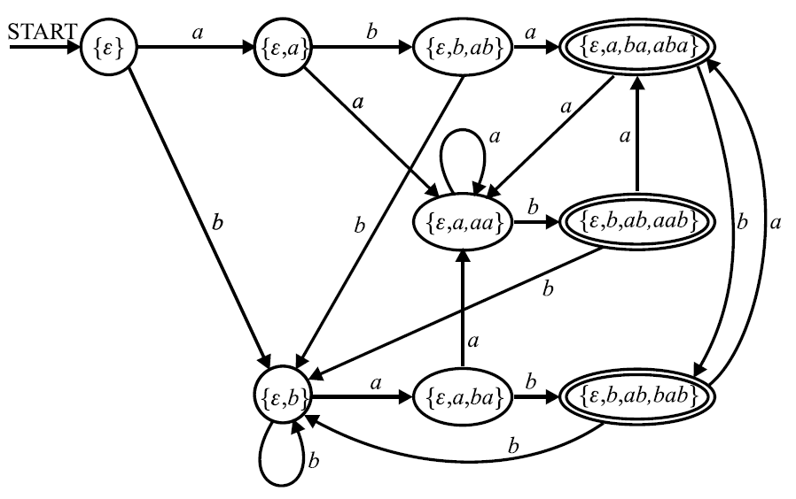
Dictionary DFA
Tiny Example
14
Alphabet = {a, b}
Dictionary = {"aba", "aab", "bab"}
DFA

Slide 16
Hamming Distance
DP Approach
15
DP approach to text search considering Hamming distance
Alphabet {a,b,c,d}, pattern P: adbbca, text T: adcabcaabadbbca.
For each each alignment P with T determine
Hamming distance between P and t[k-m+1], t[k-m+2] ..., t[k]
T:
t[1]
...
t[k-m+1]
...
t[k-1]
t[k]
...
t[n]
P:
p[1]
...
p[m-1]
p[m]
Method
Let pattern P be p[1], p[2], ..., p[m], let text T be t[1], t[2], ..., t[n].
Create dynamic programming table D[m+1][n+1], whose elements d[i][k]
are defined as follows:
1. d[0][k] = 0 // for k = 0, ..., n
2. if (p[i] == t[k]) d[i][k] = d[i-1][k-1]
else d[i][k] = d[i-1][k-1] +1 // for 1 ≤ i ≤ k, i ≤ m, k ≤ n,
Fill the table row by row. Element d[m][k] holds the Hamming distance of P
from the substring t[k-m+1], t[k-m+2] ..., t[k].

Slide 17
Hamming Distance
DP Approach?
16
Alphabet {a,b,c,d}, pattern P: adbbca, text T: adcabcaabadbbca.
D | - | a | d | c | a | b | c | a | a | b | a | d | b | b | c | a
- | 0 | 0 | 0 | 0 | 0 | 0 | 0 | 0 | 0 | 0 | 0 | 0 | 0 | 0 | 0 | 0
a | - | 0 | 1 | 1 | 0 | 1 | 1 | 0 | 0 | 1 | 0 | 1 | 1 | 1 | 1 | 0
d | - | - | 0 | 2 | 2 | 1 | 2 | 2 | 1 | 1 | 2 | 0 | 2 | 2 | 2 | 2
b | - | - | - | 1 | 3 | 2 | 2 | 3 | 3 | 1 | 2 | 3 | 0 | 2 | 3 | 3
b | - | - | - | - | 2 | 3 | 3 | 3 | 4 | 3 | 2 | 3 | 3 | 0 | 3 | 4
c | - | - | - | - | - | 3 | 3 | 4 | 4 | 5 | 4 | 3 | 4 | 4 | 0 | 4
a | - | - | - | - | - | - | - | 3 | 4 | 5 | 5 | 5 | 4 | 5 | 5 | 0
Highligted cells represent a match between the text and the pattern.
Though it looks scientifically advanced,
it is, in fact, only a basic naive approach :-).
Each diagonal corresponds to some alignment of pattern with text
where mismatches in this alignment are counted one by one.

Slide 18
Levenshtein Distance
DP Approach
17
DP approach to text search considering Levenshtein distance
Let pattern P be p[1], p[2], ..., p[m], let text T be t[1], t[2], ..., t[n].
Create dynamic programming table D[m+1][n+1], whose elements d[i][k]
are defined as follows:
1. d[i][0] = i; d[0][k] = 0, for i = 0, ..., m, k = 1, ..., n
2. // d[i][k] is computed using the information about
// the minimum possible number of applications of operations
// delete, insert, rewrite to the strings shorter by one last character
// and followed by at most one edit operation
for 1 ≤ i ≤ m, 1 ≤ k ≤ n:
d[i][k] = minimum of (
d[i−1][k] +1, // delete p[i]
if( i < m ) d[i][k−1] + 1, // insert after p[i]
d[i−1][k−1] + (p[i] == t[k]) ? 0 : 1 ) // leave or rewrite p[i]
Fill the table row by row. The cell d[m][k] contains the minimum Levenshtein
distance of P from the substring S_{x,k} = t[x], t[x+1], ..., t[k],
where x ∈ { k−m+1−d[m][k], ..., k-m+1+d[m][k] }
and the particular value of x is not known.

Slide 19
Levenshtein Distance
DP Approach
18
Alphabet {a,b,c,d}, pattern P: adbbca, text T: adcabcaabadbbca.
D | - | a | d | c | a | b | c | a | a | b | a | d | b | b | c | a
- | 0 | 0 | 0 | 0 | 0 | 0 | 0 | 0 | 0 | 0 | 0 | 0 | 0 | 0 | 0 | 0
a | 1 | 0 | 1 | 1 | 0 | 1 | 1 | 0 | 0 | 1 | 0 | 1 | 1 | 1 | 1 | 0
d | 2 | 1 | 0 | 1 | 1 | 1 | 2 | 1 | 1 | 1 | 1 | 0 | 1 | 2 | 2 | 1
b | 3 | 2 | 1 | 1 | 2 | 1 | 2 | 2 | 2 | 1 | 2 | 1 | 0 | 1 | 2 | 2
b | 4 | 3 | 2 | 2 | 2 | 2 | 2 | 3 | 3 | 2 | 2 | 2 | 1 | 0 | 1 | 2
c | 5 | 4 | 3 | 2 | 3 | 3 | 2 | 3 | 4 | 3 | 3 | 3 | 2 | 1 | 0 | 1
a | 6 | 5 | 4 | 3 | 2 | 4 | 3 | 2 | 3 | 4 | 3 | 4 | 3 | 2 | 1 | 0
Highligted cells represent a match between the text and the pattern.
d[i][k] = minimum of (
d[i−1][k] +1, // delete p[i]
if( i < m ) d[i][k−1] + 1, // insert after p[i]
d[i−1][k−1] + (p[i] == t[k]) ? 0 : 1 ) // leave or rewrite p[i]

Slide 20
Levenshtein Distance
DP Approach
19
D | - | a | d | c | a | b | c | a | a | b | a | d | b | b | c | a
- | 0 | 0 | 0 | 0 | 0 | 0 | 0 | 0 | 0 | 0 | 0 | 0 | 0 | 0 | 0 | 0
a | 1 | 0 | 1 | 1 | 0 | 1 | 1 | 0 | 0 | 1 | 0 | 1 | 1 | 1 | 1 | 0
d | 2 | 1 | 0 | 1 | 1 | 1 | 2 | 1 | 1 | 1 | 1 | 0 | 1 | 2 | 2 | 1
b | 3 | 2 | 1 | 1 | 2 | 1 | 2 | 2 | 2 | 1 | 2 | 1 | 0 | 1 | 2 | 2
b | 4 | 3 | 2 | 2 | 2 | 2 | 2 | 3 | 3 | 2 | 2 | 2 | 1 | 0 | 1 | 2
c | 5 | 4 | 3 | 2 | 3 | 3 | 2 | 3 | 4 | 3 | 3 | 3 | 2 | 1 | 0 | 1
a | 6 | 5 | 4 | 3 | 2 | 4 | 3 | 2 | 3 | 4 | 3 | 4 | 3 | 2 | 1 | 0
Challenge
Value d[m][k] registers only the distance of a substring S in the text whose end
is aligned with end of P and it is the minimum distance of all such substrings.
There is no reference in the DP table to the actual length of S i.e. to its
start position. To find string
S = S_{x} = t[x], t[x+1] ..., t[k], where x ∈ {k−m+1−d[m][k], ..., k−m+1+d[m][k] }
we must consider all values of x and compute Levenshtein distance (S_{x}, P)
for each x separately and choose x which attains minimum.

Slide 21
Levenshtein Distance
DP Approach
20
D | - | a | d | c | a | b | c | a | a | b | a | d | b | b | c | a
- | 0 | 0 | 0 | 0 | 0 | 0 | 0 | 0 | 0 | 0 | 0 | 0 | 0 | 0 | 0 | 0
a | 1 | 0 | 1 | 1 | 0 | 1 | 1 | 0 | 0 | 1 | 0 | 1 | 1 | 1 | 1 | 0
d | 2 | 1 | 0 | 1 | 1 | 1 | 2 | 1 | 1 | 1 | 1 | 0 | 1 | 2 | 2 | 1
b | 3 | 2 | 1 | 1 | 2 | 1 | 2 | 2 | 2 | 1 | 2 | 1 | 0 | 1 | 2 | 2
b | 4 | 3 | 2 | 2 | 2 | 2 | 2 | 3 | 3 | 2 | 2 | 2 | 1 | 0 | 1 | 2
c | 5 | 4 | 3 | 2 | 3 | 3 | 2 | 3 | 4 | 3 | 3 | 3 | 2 | 1 | 0 | 1
a | 6 | 5 | 4 | 3 | 2 | 4 | 3 | 2 | 3 | 4 | 3 | 4 | 3 | 2 | 1 | 0
Only few
DAG edges
are shown
here
Highligted cells represent a match between the text and the pattern.
d[i][k] = minimum of (
d[i−1][k] +1, // delete p[i]
if( i < m ) d[i][k−1] + 1, // insert after p[i]
d[i−1][k−1] + (p[i] == t[k]) ? 0 : 1 ) // leave or rewrite p[i]
a d c a
a d c a b c a
a b c a
a a b a
a b a
In each table cell d[i][k], register as predecessor(s) those of the three neighbour cells
d[i−1][k], d[i][k−1], d[i−1][k−1] which may be used to calculate the value in this cell.
Each path, in the resulting DAG, from the table bottom row to its 2nd row represent
one substring in the text which distance from the pattern is equal to the value
in the path root.

Slide 22
Levenshtein distance
Recall
21
Dist("BETELGEUSE","BRUXELLES") = 6
B E T E L G E U S E
0 1 2 3 4 5 6 7 8 9 10
B 1 0 1 2 3 4 5 6 7 8 9
R 2 1 1 2 3 4 5 6 7 8 9
U 3 2 2 2 3 4 5 6 6 7 8
X 4 3 3 3 3 4 5 6 7 7 8
E 5 4 3 4 3 4 5 5 6 7 7
L 6 5 4 4 4 3 4 5 6 7 8
L 7 6 5 5 5 4 4 5 6 7 8
E 8 7 6 6 5 5 5 4 5 6 7
S 9 8 7 7 6 6 6 5 5 5 6

Slide 23
Levenshtein distance
Recall and Compare
22
Levenshtein distance of strings
Old stuff
Dist(A, B) = |m−n| if n = 0 or m = 0
Dist(A, B) = 1+ min ( Dist(A[1..n−1], B[1..m]), if n > 0 and m > 0
Dist(A[1..n], B[1..m−1]), and A[n] ≠ B[m]
Dist(A[1..n−1], B[1..m−1]) )
Dist(A, B) = Dist(A[1..n−1], B[1..m−1]]) if n > 0 and m > 0
and A[n] = B[m]
Calculation corresponds to ... Operation
1+ Dist(A[1..n −1], B[1..m]), ... Insert(A, n−1, B[m]) or Delete(B, m)
1+ Dist(A[1..n], B[1..m−1]), ... Insert(B, m−1, A[n]) or Delete(A, n)
1+ Dist(A[1..n −1], B[1..m−1]) ... Rewrite(A, n, B[m]) or Rewrite(B, m, A[n])
Text search considering Levenshtein distance
New stuff
d[i][k] = minimum of (
d[i−1][k] +1, // Delete p[i]
if (i < m) d[i][k−1] +1, // Insert after p[i]
d[i−1][k−1] + (p[i] == t[k])?0:1) ) // leave or Rewrite p[i]

Slide 24
Text Search Using Automata
Summary
23
Text search using finite automata brings in many possibilities
regarding what can be effectively found:
A. Any given exact pattern P. (e.g. ababccabc)
B. Any word of any language specified by a particular DFA or NFA.
(Just add the loop labeled by the whole alphabet to the start state.)
C. Any string which represents some modification of the pattern P:
A string within (or exactly at) a given Hamming distance from P
A string within (or exactly at) a given Levenshtein/edit distance from P.
D. Any of strings in a given (finite) dictionary.
E. Any word of any language described by a regular expression.
F. Any union, intersection, concatenation, iteration of any of cases A. - F.
G. Any string containing any of cases A. - F. as a subsequence.
(Just add the loops labeled by the whole alphabet to all states.)

Slide 25
Text Search
Boyer-Moore
24
The idea:
Align the pattern with the text and start matching
backwards from the end of the pattern.
When a mismatch occurs there is a chance that the pattern may be shifted forward by many positions and sometimes by the whole pattern length.
Ideal case
mismatch
Text
x
Pattern
y
Pattern does not contain symbol x.
Shift after mismatch
y
The longer is the pattern the more effective is the search.
(The bigger the data the faster the algorithm, quite an unusual situation...)

Slide 26
Text Search
Boyer-Moore
25
Mismatch at the last position of the pattern.
Bad Character Shift table (BCS)
When the last symbol of pattern (y) is mismatched with symbol x in the text
shift the pattern to the right to match the first occurrence (from the end) of x
in the pattern with x in the text.
When the pattern does not contain x shift it by its whole length.
BCS is indexed by all symbols of alphabet.
For each symbol in the pattern it contains the symbol’s minimum distance
from the end of the pattern. If the symbol is not in the pattern
then the table entry is equal to the pattern length.
Example
Mismatch
Text
B
C
C
F
A
B
B
E
C
Text
x
Pattern
F
A
B
B
E
Pattern
x
x
y
BCS
BCS
A
B
C
D
E
F
Shift after mismatch
x
x
y
3
1
5
5
0
4

Slide 27
Text Search
Boyer-Moore
26
Mismatch after partial match at the end of the pattern.
When a suffix S of the pattern matches the text and the symbol x immediately
preceding S mismatches the text then there are three cases:
1. The suffix S occurs more times in the pattern and the other occurrence is not immediately preceded by x. In this case, shift the pattern so that the nearest described instance of S matches the text again at the same position. That is, shift the pattern by the distance between these occurrences of suffix S.
Example
Mismatch
Text
b
x
y
z
Pattern
c
x
y
z
a
x
y
z
a
x
y
z
Shift after mismatch
c
x
y
z
a
x
y
z
a
x
y
z
Here could be b !
No need to try to match a another time

Slide 28
Text Search
Boyer-Moore
27
2. There is a suffix W whose length does not exceed the length of S and W is also
a prefix of the pattern. Take the longest possible W and denote its occurrence at the beginning of the pattern by Q.
Then shift the pattern by the distance between Q and W.
Example
Text
b
z
x
y
x
y
Pattern
x
y
x
y
b
f
l
m
a
z
x
y
x
y
Shift after mismatch
x
y
x
y
b
f
l
m
a
z
x
y
x
y
Longest suffix after mismatch
which is also a prefix
3. Neither case 1. nor case 2. happens. Then shift the pattern by its whole length.
Example is unnecessary

Slide 29
Text Search
Boyer-Moore
28
The shift can be calculated for all three cases :
Take suffix S as a separate string and align it with its original position in the pattern. Then keep shifting S to to the left until one of the cases 1., 2., 3. is
detected (at least 3. must happen after some time).
Register the distance between the current and the original position of S.
Good Suffix Shift (GS) table contains the shift values for all suffixes S.
Example
GS
Pattern
A
D
B
A
C
B
A
C
B
A
position | mismatches | suffix | shift
9 | B | A | 9
8 | C | BA | 6
7 | A | CBA | 9
6 | B | ACBA | 9
5 | C | BACBA | 3
4 | A | CBACBA | 9
3 | B | ACBACBA | 9
2 | D | BACBACBA | 9
1 | A | DBACBACBA | 10
0 | - | ADBACBACBA | 9
Pattern length: 10
Positions indexed from 1,
0 represents shift after
complete match.
Apply case 2. after complete match

Slide 30
Text Search
Boyer-Moore
29
Example
Pattern
BCS
GS
_
A
E
K
L
N
O
P
S
T
V
0
1
2
3
4
5
6
7
8
9
P
O
V
A
L
O
V
A
L
9
1
9
9
4
9
3
8
9
9
2
9
9
9
9
9
4
9
9
9
-
P
O
V
A
L
O
V
A
L
Search progress
BCS[P] == 8
GS[5] == 4
GS[6] == 9
Text
O
N
_
S
E
_
V
_
P
A
L
_
P
O
V
A
L
O
V
A
L
_
A
_
N
E
K
V
A
L
T
O
V
A
L
P
O
V
A
L
O
V
A
L
P
O
V
A
L
O
V
A
L
P
O
V
A
L
O
V
A
L
P
O
V
A
L
O
V
A
L
L
P
O
V
A
L
O
V
A
L
L

