Slide 1
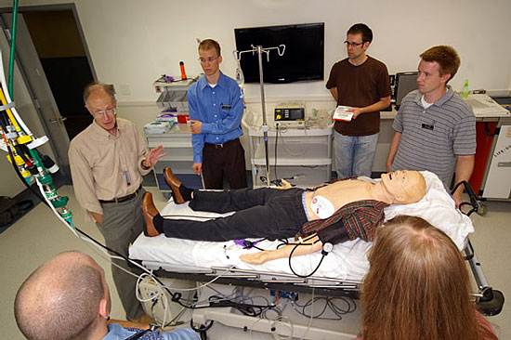
Modelování cirkulačního systému
v lékařském simulátoru METI

Slide 2
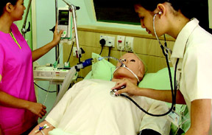
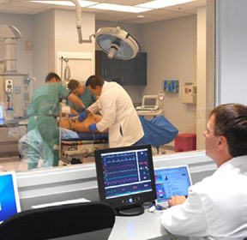
METI‘S Human Patient Simulator (HPS)

Slide 3
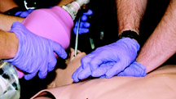
METI‘S Human Patient Simulator (HPS)

Slide 4
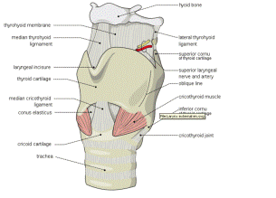
METI‘S Human Patient Simulator (HPS)
ADULT MANNEQUIN:
Full-size reproduction of an adult male or female patient with interchangeable genitalia
Fully operational in supine, sitting, lateral and prone positions
Demonstrates clinical signs such as heart, breath and bowel sounds, palpable pulses, chest excursion and airway patency, which are dynamically coupled with mathematical models of human physiology and pharmacology airway.
Realistic adult upper airway (oropharynx, nasopharynx and larynx)
Direct laryngoscopy and oral or nasal tracheal intubation
Right or left mainstem endobronchial intubation automatically results in unilateral breath sounds and chest excursion
Esophageal intubation results in gastric distension and the absence of breath sounds, chest excursion and carbon dioxide output
Airway visualization occluder
Varying degrees of tongue swelling, hindering laryngoscopy and endotracheal intubation
Laryngospasm
Needle cricothyrotomy, transtracheal jet ventilation, retrograde wire techniques and tube cricothyrotomy can be practiced
Supports standard clinical devices such as combitubes, lighted stylets and fibre-optic intubation tubes

Slide 5
METI‘S Human Patient Simulator (HPS)
PULMONARY:
Spontaneous respiration
Mechanical ventilation
Assisted ventilation
Chest excursion
Oxygen consumption
Uptake and elimination of anesthetic gases
Variable lung and thorax compliance
Variable airway resistance
Breath sounds
Intrapleural volume
Functional residual capacity

Slide 6
METI‘S Human Patient Simulator (HPS)
CARDIOVACULAR:
Heart sounds
Electrocardiogram
Palpable carotid, radial, brachial, femoral, popliteal and pedal pulses
Cardiac output
Cardiac dysrhythmias
Arterial blood temperature
Central venous pressure
Hemodynamic monitoring
Pulmonary artery catheter
Chest compression
Airway management and ventilation
Cardiac arrhythmias
Defibrillation
Pacing
Cardioversion

Slide 7
METI‘S Human Patient Simulator (HPS)
PHARMACOLOGIC:
Includes library of pre-programmed pharmacokinetic and pharmacodynamic parameters for over 50 intravenous medications
Barcode reader identifies drug, concentration and dosage and patient responds appropriately
Three intravenous access points: right arm, right internal jugular and left femoral veins

Slide 8
METI‘S Human Patient Simulator (HPS)
PATIENT MONITORING:
Connects to standard patient monitors to display the following parameters:
Arterial blood pressure
Left ventricular pressure
Central venous pressure
Right arterial pressure
Right ventricular pressure
Pulmonary artery pressure
Thermodilution cardiac output
Pulmonary capillary occlusion pressure
Pulmonary artery catheter insertion
NIBP
5-lead ECG
SpO2
Temperature
Inspired and expired gas concentrations and ventilatory mechanics can be measured and displayed on respiratory gas monitors

Slide 9
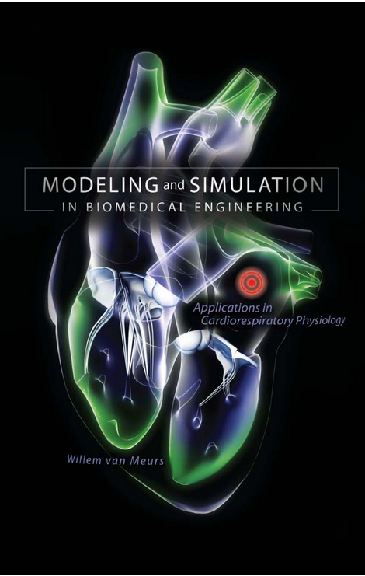
METI‘S Human Patient Simulator (HPS)
Model pacienta
rozhraní
Model pacienta
posluchači
Stavový automat
rozhraní
Model přístroje
učitel
Lékařský přístroj
rozhraní
simulátor
Figurína pacienta
Willem van Meurs:
Modeling and Simulation in Biomedical Engineering, Applications in Cardiorespiratory Physiology

Slide 10
Konceptuální schéma

Slide 11
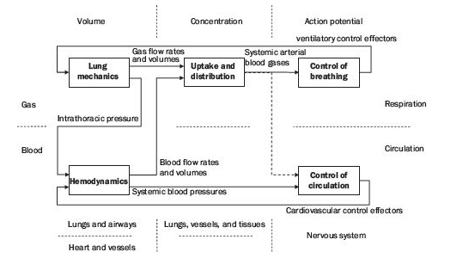
Konceptuální schéma

Slide 12
Konceptuální schéma

Slide 13
Konceptuální schéma

Slide 14
Konceptuální schéma

Slide 15
Konceptuální schéma

Slide 16
Konceptuální schéma

Slide 17
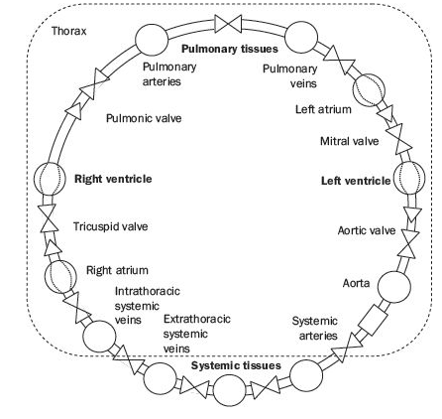
Konceptuální schéma

Slide 18
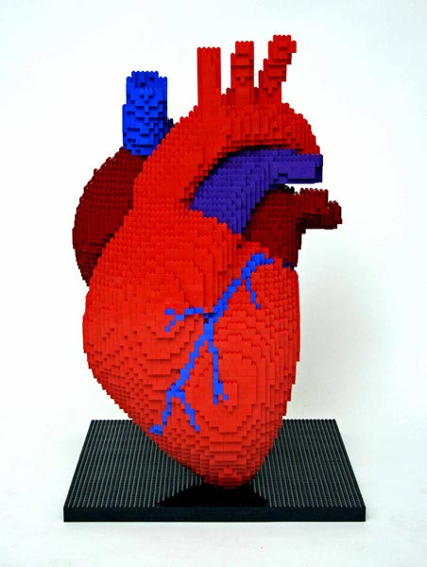
Komponenty

Slide 19
Propojky vtok/výtok

Slide 20
Propojky vtok/výtok
connector BloodFlowConnector "Connector for blood flow"
flow Real Q "blood flow in ml/sec";
Real Pressure "Pressure in torr";
end BloodFlowConnector;
connector BloodFlowInflow "Blood flow inflow"
flow Real Q "blood inflow in ml/sec";
Real Pressure "Pressure in torr";
end BloodFlowInflow;
connector BloodFlowOutflow "Blood flow inflow"
flow Real Q "blood flow outflow in ml/sec";
Real Pressure "Pressure in torr";
end BloodFlowOutflow;

Slide 21
Propojky vtok/výtok
flow Real Q
flow Real Q
Real Pressure
Real Pressure
partial model BloodFlowOnePort
BloodFlowInflow Inflow;
BloodFlowOutflow Outflow;
Real PressureDrop;
Real BloodFlow;
equation
PressureDrop=Inflow.Pressure - Outflow.Pressure;
Inflow.Q + Outflow.Q=0;
BloodFlow=Inflow.Q;
end BloodFlowOnePort;

Slide 22
Resistor

Slide 23
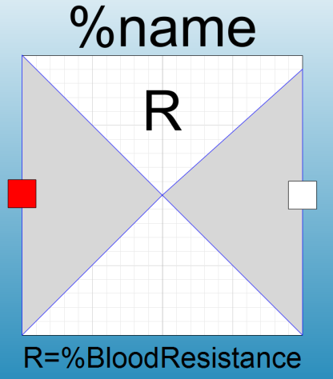
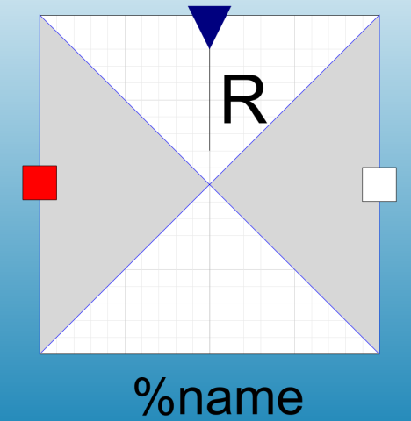
Resistor
model BloodResistor
parameter Real BloodResistance(start=1) "resistance in torr sec/ml";
extends BloodFlowOnePort;
equation
PressureDrop=BloodFlow*BloodResistance;
end BloodResistor;
model VariableBloodResistor
extends BloodFlowOnePort;
Modelica.Blocks.Interfaces.RealInput BloodResistance "in torr sec/ml“;
equation
PressureDrop=BloodFlow*BloodResistance;
end VariableBloodResistor;

Slide 24
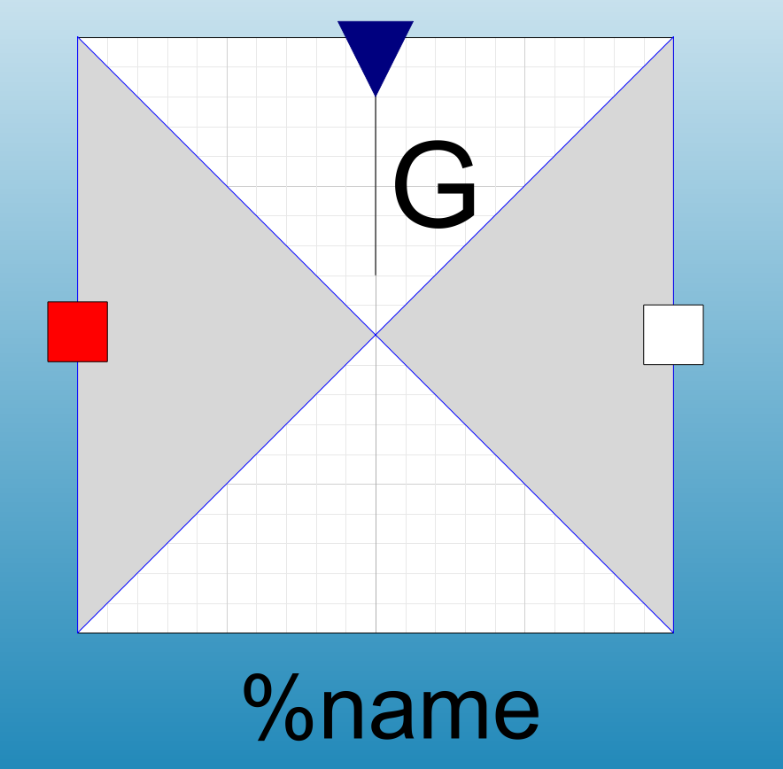
Conductor
model VariableBloodConductance
extends BloodFlowOnePort;
Modelica.Blocks.Interfaces.RealInput BloodConductance "in torr ml/sec“;
equation
PressureDrop*BloodConductance=BloodFlow;
end VariableBloodConductance;

Slide 25
Compliance

Slide 26
Compliance
Blood Elastic Compartment
Místo dvou konektorů (vtok/výtok) stačí jeden konektor

Slide 27
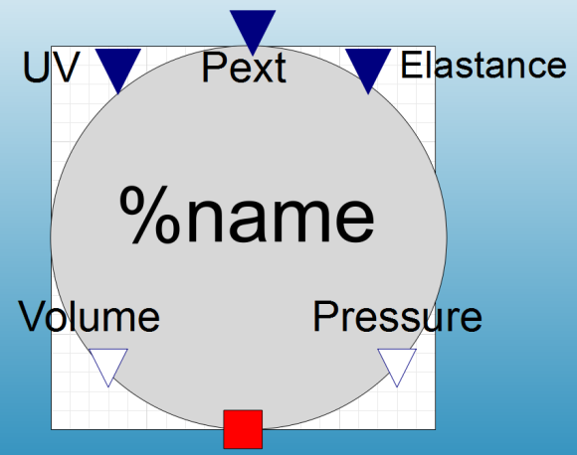
Compliance – Blood Elastic Compartment
model BloodElasticCompartment "Elastic compartment with unstressed volume"
Modelica.Blocks.Interfaces.RealInput Elastance "\"in torr/ml\“;
Modelica.Blocks.Interfaces.RealOutput Volume(start=V0);
Modelica.Blocks.Interfaces.RealInput ExternalPressure "\"in torr\„“;
Modelica.Blocks.Interfaces.RealInput UnstressedVolume "in ml“;
parameter Real V0=1 "initial volume in ml";
Real StressedVolume;
Real TransmuralPressure;
Modelica.Blocks.Interfaces.RealOutput Pressure "Blood pressure in torr“;
BloodFlowConnector bloodFlow;
equation
bloodFlow.Pressure=Pressure;
TransmuralPressure=Pressure - ExternalPressure;
der(Volume)=bloodFlow.Q;
StressedVolume=Volume - UnstressedVolume;
if StressedVolume > 0 then
TransmuralPressure=Elastance*StressedVolume;
else
TransmuralPressure=0;
end if;
end BloodElasticCompartment;

Slide 28
Inductor

Slide 29
Inductor
Setrvačnost krve

Slide 30
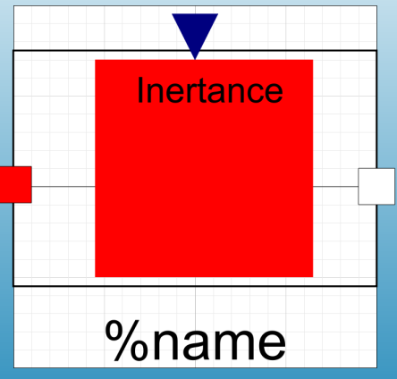
Inductor
model Inductor
extends BloodFlowOnePort;
Modelica.Blocks.Interfaces.RealInput Inertance "in torr * sec^2/ml“;
equation
PressureDrop=der(BloodFlow)*Inertance;
end Inductor;

Slide 31
Valve

Slide 32
Valve

Slide 33
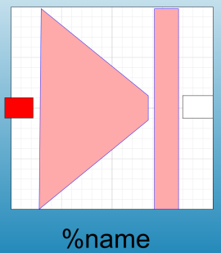
Valve
model Valve
BloodFlowInflow bloodFlowInflow;
BloodFlowOutflow bloodFlowOutflow;
Real q;
Real dp;
Boolean open(start=true);
Real passableVariable;
equation
bloodFlowInflow.Q + bloodFlowOutflow.Q=0;
q=bloodFlowInflow.Q;
dp=bloodFlowInflow.Pressure - bloodFlowOutflow.Pressure;
open=passableVariable > 0;
if open then
dp=0;
q=passableVariable;
else
dp=passableVariable;
q=0;
end if;
end Valve;

Slide 34
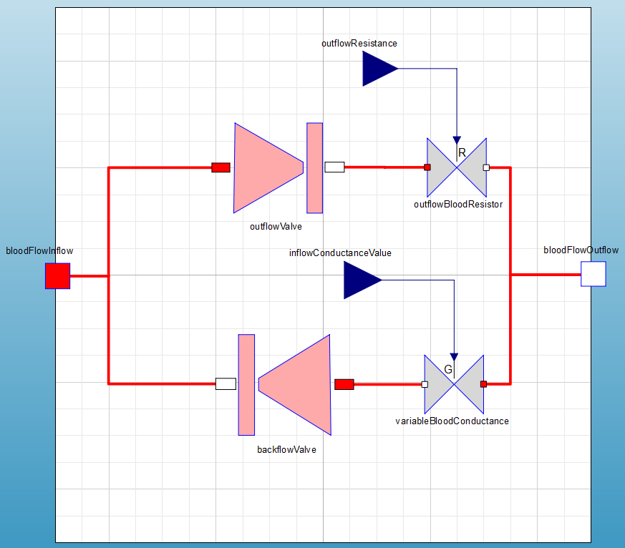
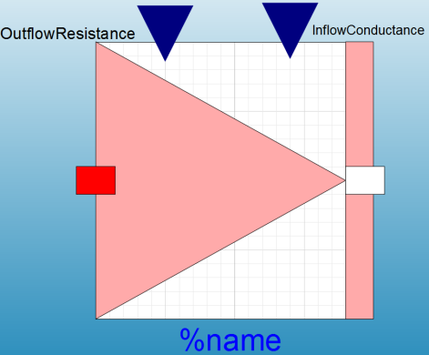
CardiacValve

Slide 35
Time-Varying Compliance (or Elastance)

Slide 36
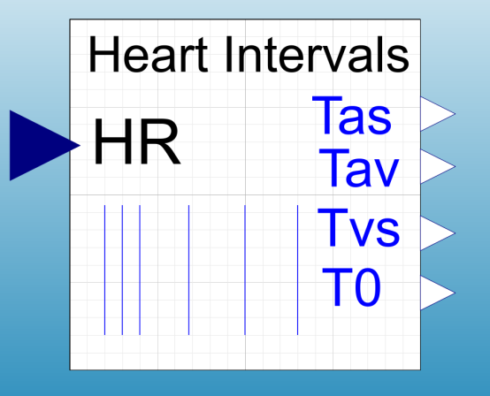
HeartIntervals
model heartIntervals
Modelica.Blocks.Interfaces.RealInput HR;
RealDiscreteOutput Tas "duration of atrial systole“;
RealDiscreteOutput Tav "atrioventricular delay“;
RealDiscreteOutput Tvs "duration of ventricular systole“;
RealDiscreteOutput T0 "start time of systole in sec“
discrete Real HP(start=0) "heart period - duration of cardiac cycle in sec";
Boolean b(start=false);
equation
b=time - pre(T0) >= pre(HP);
when b then
T0=time;
HP=60/HR;
Tas=0.03 + 0.09*HP;
Tav=0.01;
Tvs=0.16 + 0.2*HP;
end when;
end heartIntervals;

Slide 37
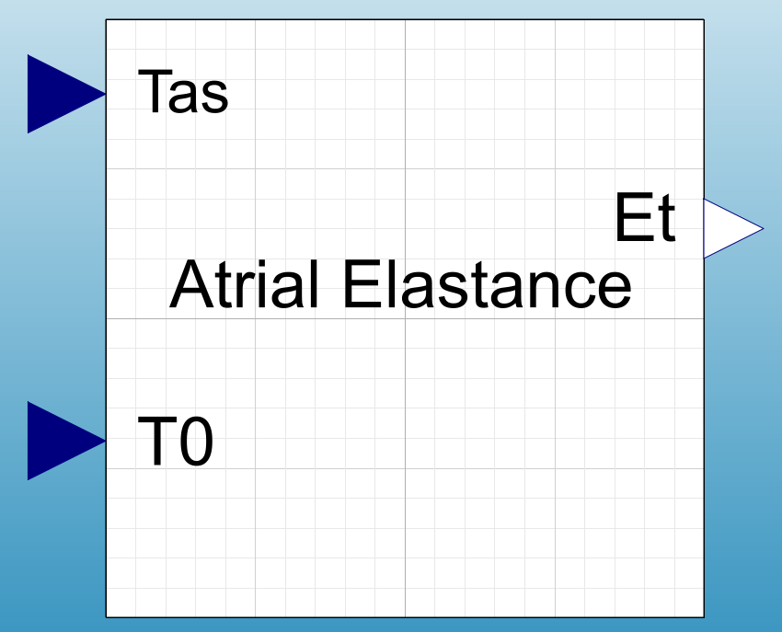
AtrialElastance
model AtrialElastance
Modelica.Blocks.Interfaces.RealInput Tas "duration of atrial systole“;
Modelica.Blocks.Interfaces.RealOutput Et "elasticity (torr/ml)“;
Modelica.Blocks.Interfaces.RealInput T0 "time of start of cardiac cycle ;
parameter Real EMIN=0.05 "Diastolic elastance (torr/ml)";
parameter Real EMAX=0.15 "Maximum systolic elastance (tor/ml)";
equation
if time - T0 < Tas then
Et=EMIN + (EMAX - EMIN)*sin(Modelica.Constants.pi*(time - T0)/Tas);
else
Et=EMIN;
end if
end AtrialElastance;

Slide 38
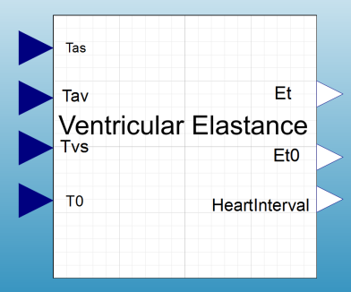
VentricularElastance
model VentricularElastance
Modelica.Blocks.Interfaces.RealInput Tas "duration of atrial systole“;
Modelica.Blocks.Interfaces.RealOutput Et "elasticity (torr/ml)“;
Modelica.Blocks.Interfaces.RealInput T0 "time of start of cardiac cycle „;
Modelica.Blocks.Interfaces.RealInput Tav "atrioventricular delay“;
Modelica.Blocks.Interfaces.RealInput Tvs "duration of ventricular systole“);
Modelica.Blocks.Interfaces.RealOutput Et0 "elasticity (torr/ml)“;
Modelica.Blocks.Interfaces.RealOutput HeartInterval "elasticity (torr/ml)“;
constant Real Kn=0.57923032735652;
parameter Real EMIN=0 "Diastolic elastance (torr/ml)";
parameter Real EMAX=1 "Maximum systolic elastance (tor/ml)";
equation
HeartInterval=time - T0;
Et=EMIN + (EMAX - EMIN)*Et0;
if HeartInterval >= Tas + Tav and HeartInterval < Tas + Tav + Tvs then
Et0=(HeartInterval - (Tas + Tav))/Tvs*sin(Modelica.Constants.pi*(HeartInterval - (Tas + Tav))/Tvs)/Kn;
else
Et0=0;
end if;
end VentricularElastance;

Slide 39
Skládáme Lego

Slide 40
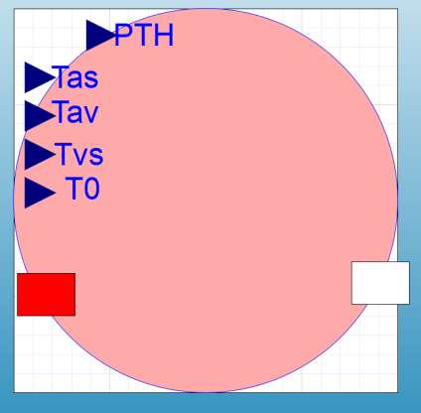
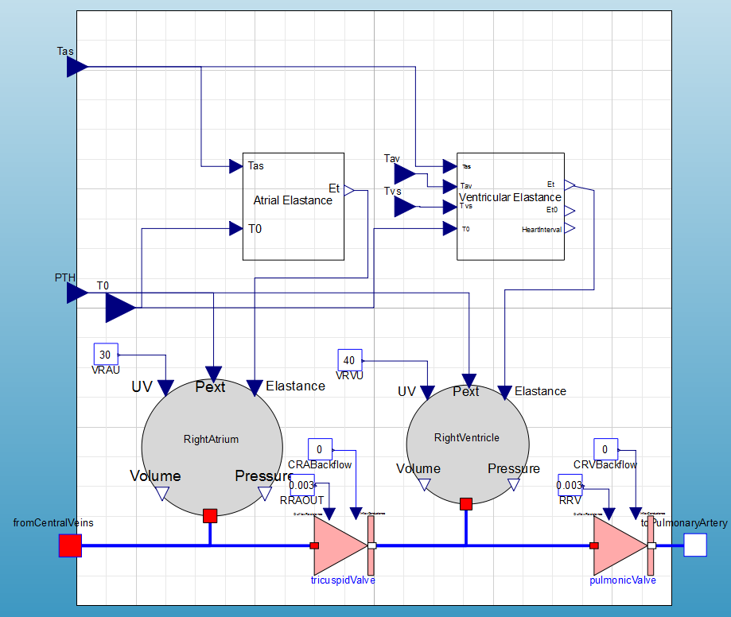
RightHeart

Slide 41
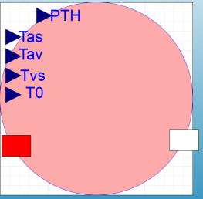
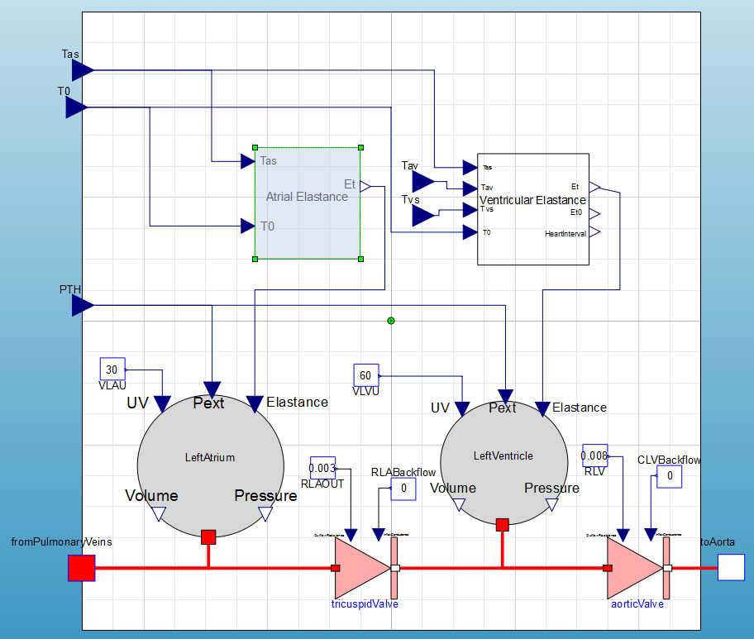
LeftHeart

Slide 42
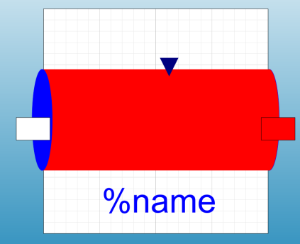
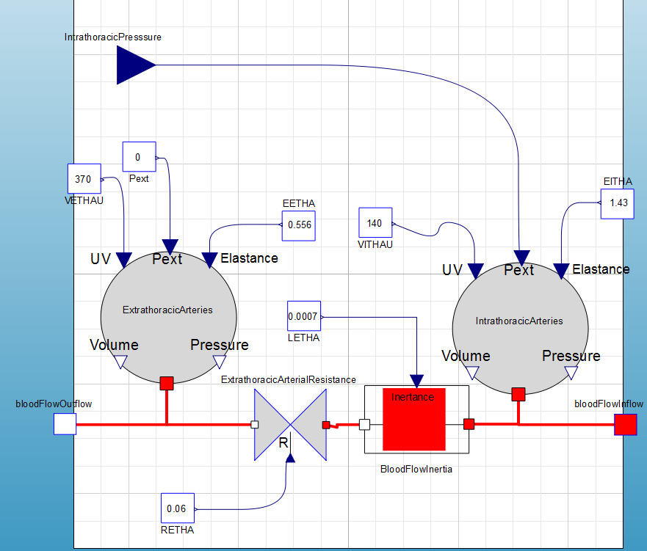
SystemicArteries

Slide 43
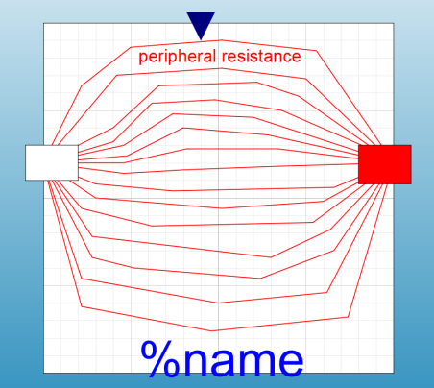
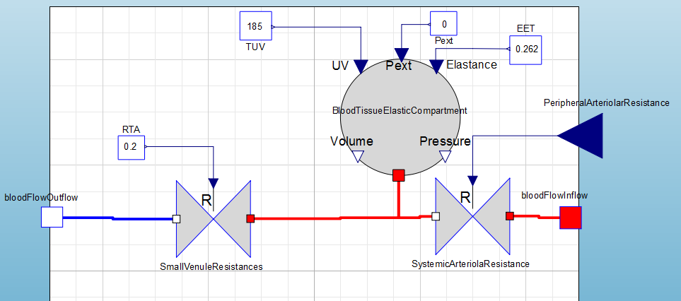
SystemicPeripheralVessels

Slide 44
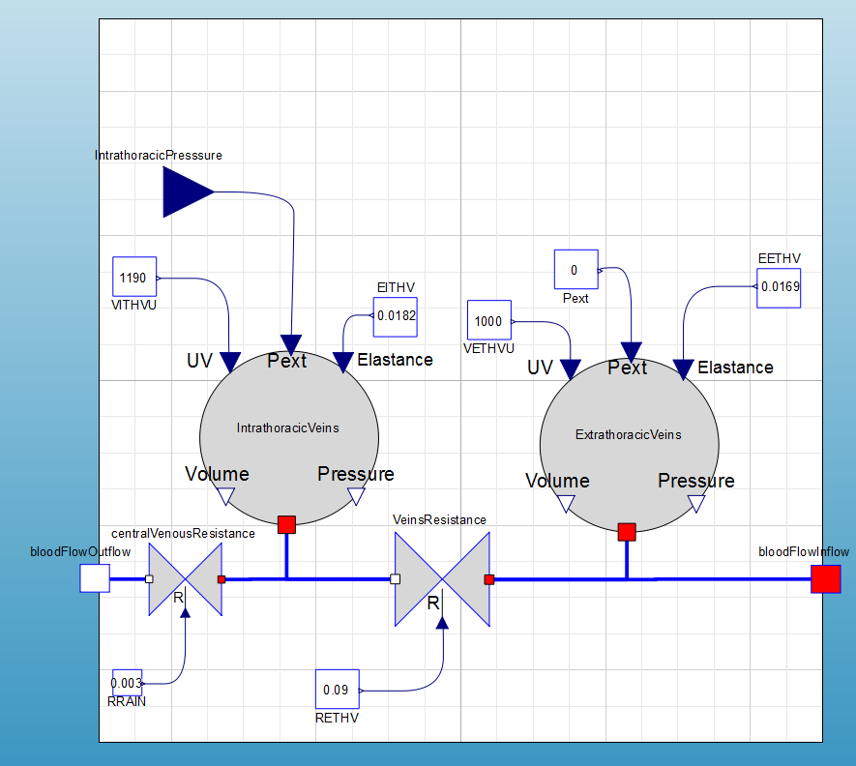
SystemicVeins

Slide 45
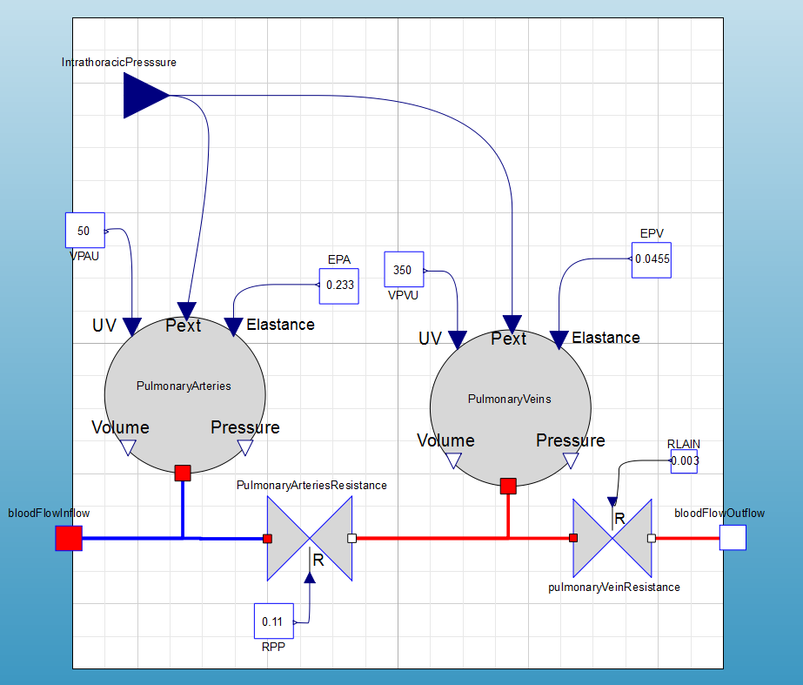
PulmonaryCirculation

Slide 46
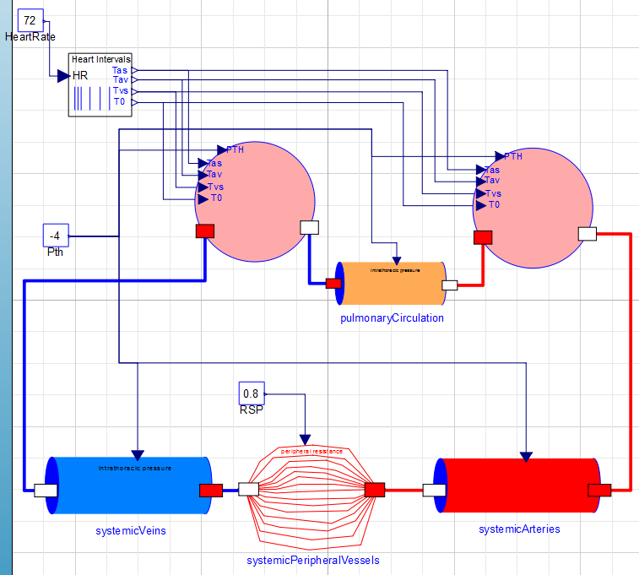
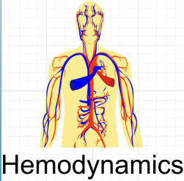

Slide 47
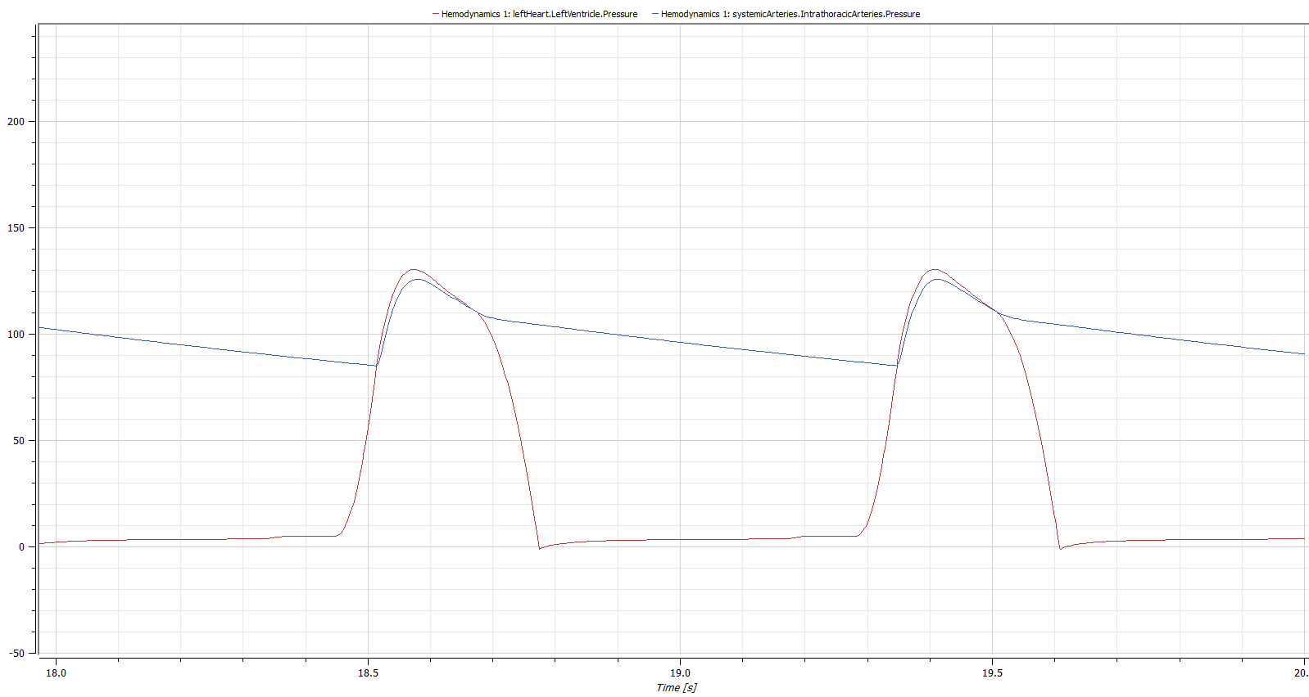
Výstup modelu – tlaky v levé síni a v aortě

